Slide 1
Building Capacity and Confidence in Gender Transformative Programming: A Virtual Learning Experience
Module 1

Slide 2
Session 1:
Introduction

Slide 3
Overall Training Objective
This training program is about strengthening the confidence and capacity for both gender equality experts and non-experts in the application of gender transformative programming in women’s and children’s health.

Slide 4
TRAINING MODULES
 | MODULE 1: Gender Equality Concepts and Terminology Participants will have increased familiarity with, and confident use of key concepts and terminology related to gender equality.
 | MODULE 2: Elements of Gender Transformative Programming Participants will strengthen their understanding of and ability to practically support the design of gender transformative programs and initiatives.
 | MODULE 3: Gender Based Analysis and Monitoring and Evaluation Participants will be introduced to key accountability tools for Gender Transformative Programming, and will understand how they can be used in their own work.
Notes:
This training program is about strengthening the confidence and capacity for both gender equality experts and non-experts in the application of gender transformative programming in women’s and children’s health
This is a 3-day training program, consisting of 3 Core Modules:
Gender Equality Concepts and Terminology
Elements of Gender Transformative Programming
Gender Based Analysis and Monitoring and Evaluation

Slide 5
TRAINING PRINCIPLES
Participation: Each one of you brings a wealth of experience to the program. Participate fully and give everyone a chance to contribute, encouraging others to do so.
Respect Others: Respect each other, yourselves, and the trainer. Do not speak when someone else is speaking. Listen actively.
Support an inclusive environment: Support an environment of inclusion and respect diversity in all its forms. Discrimination or exclusion of any kind will not be accepted.
Agree to Disagree: Feel free to express opinions and concerns. Everyone should contribute to a safe/non-judgemental environment.
Punctuality: Arrive on time to each workshop session. Arriving late is a sign of disrespect to the trainer and to your fellow participants.
Minimize Disturbances: Cell phones should be turned off at the beginning of the workshop and remain off until the end. Avoid side conversations and please ask the facilitator to clarify.
Ask Questions: There are no stupid questions. If you do have a question you don’t want to ask in front of others, ask it privately during a break. Please do not think any question you have is unimportant.

Slide 6
Introductions
1
Change zoom handle to your name and which organization you are from (if you are with an org).
Step
2
Step
Introduce yourself: Name, which org you belong to (if you do), and where in the world you’re located!
3
Step
What would you like to strengthen in your own work as it relates to Gender Equality (professional training take-away)?
Notes:
There is animation on this slide - Each slide fades in on Click

Slide 7
Activity 1.1: Our Participation
1
Go to Activity 1.1 in your Participant Resource Package to see detailed activity instructions.
Step
2
Step
Independently, think of 3 examples that describe the way you participate in group settings.
3
Step
Click on the Sli.do link provided within the activity instructions to join the “word cloud poll.” Once in Sli.do, populate 1 example at a time, where prompted.
4
Step
You will have 3 minutes to brainstorm and populate your responses. Feel free to type more than 3 responses!
Remember: Take it slow! Use this activity to become familiar with Sli.do and feel free to ask any questions to the facilitator(s)!
Notes:
There is animation on this slide - Each slide fades in on Click
*once everyone is done populating their own examples, return to the zoom call. The final word cloud will be screenshared by the hosts!
Remember: Take is slow! Use this activity to become familiar with Sli.do and feel free to ask any questions to the facilitator(s)!

Slide 8
Concepts & Terminology
MODULE 1

Slide 9
Session 2:
Gender 101

Slide 10
Learning Objectives
To understand and feel confident using basic terminology and definitions related to gender.

Slide 11
Key Messages
 | Terminology is a ‘tool, not a rule’: use it to understand not undermine
 | This section might be a refresher for you or an introduction of key terms and their meanings; basic gender terminology will be introduced to establish a shared understanding that will align and guide us through the rest of the training program
 | Terminology will vary across the sector in different ways (and in different languages), and having a strong foundational understanding can help navigate those differences.

Slide 12
Activity 2.1: Word/Term Quiz
1
Go to Activity 2.1 in your Participant Resource Package to see detailed activity instructions.
Step
2
Step
Independently, take 10 minutes to review and complete Annex 2a: Terminology Word Quiz. Match the key term to its definition.
3
Step
You can use Annex 2b to check your work and test your own understanding!
Notes:
There is animation on this slide - Each slide fades in on Click

Slide 13
KEY DEFINITIONS
Gender
The socially and culturally constructed ideas of what it is to be male or female in a specific context.
Equality
Equal chances or opportunities for women, men, girls, boys and gender diverse people, to access and control social, economic, and political resources, and protects these opportunities under law (i.e. health services, education or voting rights).
Gender Unaware
Ignores gender norms, roles and relations and very often reinforces or aggravate gender-based discrimination.
Gender Transformative
Addresses the causes of gender-based health inequities by including specific ways to shift harmful gender norms, roles and relations with explicit intentions to change unequal power relations (i.e. seeking to change social position/how they are valued in society).
Women and Girls’ Empowerment
The expansion of choice and the strengthening of voice through the transformation of power relations so that women and girls have more control over their lives and futures.
Notes:
This slide has animation - the definitions fly in from the right

Slide 14
Men should drive, rather than women.
Gender Norms
Women are excluded from roles involving driving (taxi, paramedic, police).
Gender Discrimination
and Bias
Roles and Behaviour
Women don’t spend a lot of time driving and are not seen driving very often.
Gender Stereotypes
“Women are bad drivers”

Slide 15
Key Takeaways
Terminology is a ‘tool, not a rule’
Basic gender terminology establishes a shared understanding
Terminology varies across the sector
Notes:
Key Note: want to make the point tomorrow of how these discussions are tools and these definitions are tools Flag the podcast “Speaking of Gender” - https://crooked.com/podcast/speaking-of-gender/

Slide 16
Session 3:
Gender Equality and Change
Understanding Transformative Change

Slide 17
Learning Objectives
To gain a deeper understanding, beyond terminology, of gender equality concepts.

Slide 18
Key Messages
 | Learning terminology is just one part of the skills needed to advance gender equality in your programming, this session will help participants understand the concepts behind the change you are proposing/supporting.

Slide 19
Gender
Transformative
Change
Gender transformative change is defined as a deep structural change achieved by addressing the root causes of gender inequality.
UN: Economic and Social Commission for Western Asia.

Slide 20
DIG IN!
How do these concepts have
a relationship to power?
Power over
people, resources and decisions
Power to
act and to realize one’s aspirations
Power with
others that comes out of cooperation and collaboration.
Power within
that comes from a sense of self-worth and self-knowledge
How could you use this concept to explain gender transformative change?
What would be some practical examples that illustrate these concepts in real-world projects?
Access to resources vs control over resources
Practical vs Strategic Needs
Condition vs Position
Notes:
This slide has animation - the questions fade in on click

Slide 22
Activity 3.1: Illustrating Gender Transformative Concepts
1
Step
Go to activity 3.1 in your Participant Resource Package to see detailed activity instructions. To complete this activity, you will be divided into 3 groups.
2
Step
You have 20 minutes to agree how you can, without words, in your groups, illustrate the assigned concept. Your assigned concept is listed under activity instructions, and you can find more info via Annex 3a to get your group started!
Practical vs Strategic Needs
3
Each group is assigned their own “virtual whiteboard” utilizing the interactive digital tool called “mural” to illustrate their concept. You can find your mural link listed with your group assignment.
Step
Condition vs Position
Access to resources vs control over resources
4
You will be moved into Zoom breakout rooms according to your group assignments. Read the detailed activity instructions in your Participant Resource Package for more guidance. You have 20 minutes for this activity.
Step
Notes:
This slide has animation for the question. The animation flies in from the left
This slide initiates the group discussion

Slide 23
Terminology and Concepts
Feminist
Gender Unaware
Gender Responsive
Gender
Transformative
Gender Aware
Gender
Exploitative
Gender Sensitive
LOW IMPACT
HIGH IMPACT
Increased Access of Resources
Increased Control of Resources
Practical Needs
Strategic Needs
Changes in Condition
Changes in Position
Notes:
Can include gender intentional, etc. Describe that what we do next in the program is explore is that we have group work where participants explore the concepts of understanding the change.

Slide 24
Key Takeaways
Learning terminology is one part of the skills needed to advance gender equality in your programming - but understanding concepts is equally as important!

Slide 25
Session 4:
Gender Diversity

Slide 26
Learning Objectives
Understand the complexities and diversity that exists within and around gender, with a deeper look into identities that fall outside of the binary understanding of gender and how this can be applied to our work.

Slide 27
Key Messages
 | Exploring factors of diversity within and around gender will help participants move towards an understanding of intersectionality and of gender as non-binary
 | The diversity of gender expression and sexual identity is global, and work towards gender equality should reflect the rights and experiences of these groups.

Slide 28
LGBTTTQQIAA+
LGBTQ is the more commonly used term in the community.
You may also hear the terms ”Queer Community” or “Rainbow Community” used to describe LGBTQ2+ people.
The initialism and the various terms are always evolving, the most important thing is to be respectful and use the terms that people prefer.
Source: https://ok2bme.ca/resources/kids-teens/what-does-lgbtq-mean/
Source: https://ok2bme.ca/resources/kids-teens/what-does-lgbtq-mean/

Slide 29
Unpacking Non-binary Gender Identity
Source: https://transstudent.org/gender/

Slide 30
Key Takeaways
 | Exploring factors of diversity within and around gender will help participants move towards an understanding of intersectionality and of gender as non-binary
 | The diversity of gender expression and sexual identity is global, and work towards gender equality should reflect the rights and experiences of these groups.

Slide 31
Session 5:
Intersectionality

Slide 32
Learning Objectives
To understand how power and social privilege can be used to marginalize particular groups, specifically those comprised of intersecting identities.

Slide 33
Key Messages
 | This session will unpack the concept of intersectionality and how people will experience different barriers depending on many elements of their identities—things like their sexuality, race, gender identity, ability, and age. Pursuing true equality means recognizing and meeting all peoples’ diverse needs

Slide 34
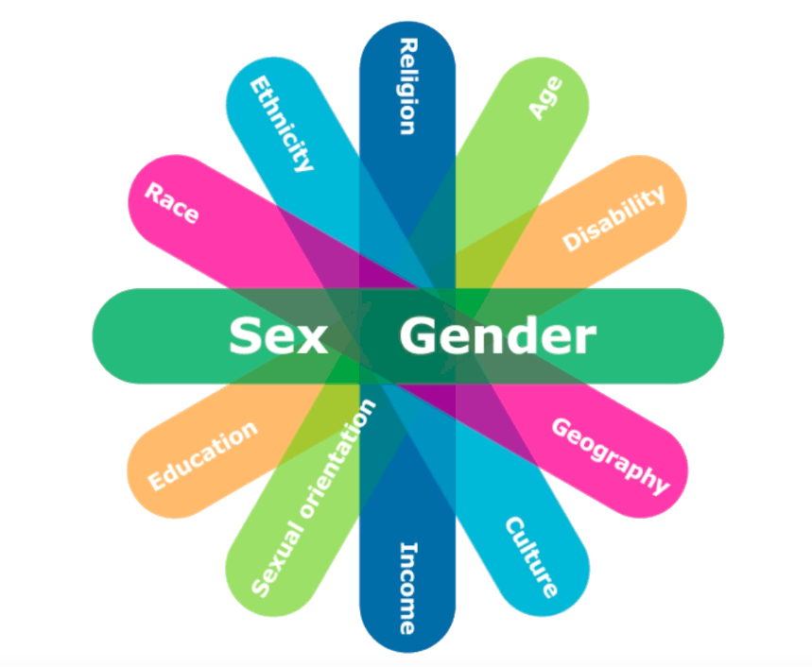
Intersectionality
A theoretical framework for understanding how aspects of a person’s identity (race, class, gender, sex, ability, religion, etc.) combine to create unique modes of discrimination or privilege. The term was coined by black feminist scholar Kimberlé Williams Crenshaw in 1989.

Slide 35
Activity 5.2: Power Walk
1
Go to activity 5.2 in your Participant Resource Package to see detailed activity instructions.
Step
2
Step
Find your name in the table provided. You will either be assigned an “active participant” role or an “observer role.” Read the instructions specific to your assignment.
3
Step
Only active participants are to sign into the Mural link provided and actively engage in the activity as their “assigned identity.”
4
Step
Observer participants are to stay on Zoom where the Mural will be broadcasted. Take notes on what you’re observing!
Notes:
There is animation on this slide
Context: We’re in a fictional land-locked country with an agrarian rural economy and a couple of thriving advanced urban centres. Communities are mostly conservative or traditional, with urban centers gradually becoming more progressive. Key gender-related issues include early marriage, high levels of HIV, tensions between customary and formal legal systems, and low representation of women in key governance and decision making positions at the community and national level.

Slide 36
Key Takeaways
Unequal power relations are at the root of gender inequality and exclusion/discrimination.
Recognizing that an individual’s particular experience of intersecting discriminations is unique.
This is particularly relevant when we think about gender and those who have gender expressions outside the binary and as they intersect with other identities/statuses.

