Slide 1
Building Capacity and Confidence in Gender Transformative Programming: A Virtual Learning Experience
Module 2

Slide 2
Elements of Gender Transformative Programming
MODULE 2

Slide 3
Session 6:
Gender in the Project Cycle

Slide 4
Learning Objectives
To understand the basic points of the project cycle that will be used for the training, and how it applies to their work.

Slide 5
Key Messages
 | Regardless of your organization’s mandate, a project cycle is a universal and practical approach to understanding the processes within which gender equality and feminist approaches can be integrated.
 | The journey through this training will be hands-on and practical, requiring everyone’s active participation.

Slide 6
Project Cycle
These sessions will explore problem analysis from a gender perspective, rights-based and instrumentalist approaches, taking an holistic approach, and designing transformative programming with gender equality outcomes.
Planning and Design
These sessions will introduce participants to the spectrum of gender equality integration into MEAL, from gender sensitive through to feminist MEAL. They will be introduced to the Gender Based Analysis Plus (GBA+), design indicators for GE outcomes, and explore how data can be collected and used for gender transformative programming.
Monitoring, Evaluation and Learning
Implementation
This session will ask participants to examine different aspects that are key to effective implementation (resources, skills, time) from a gender perspective, exploring the needs, challenges and risks associated with gender transformative programming.
Notes:
Note - this is a very simplified project cycle! More comprehensive project cycles would include many more points in the cycle - but for us, we’re going to focus on three broad moments in the cycle.

Slide 7
Session 7:
Problem Analysis from a Gender Perspective

Slide 8
Learning Objectives
To become comfortable with the application of a gender lens, and the identification of ‘root causes’.

Slide 9
Key Messages
 | In order to design gender transformative programming, we need to have a deep understanding of the gendered nature of the problem, right down to the root causes.
 | Revising our conceptual understanding of gender inequality can help us to explore these root causes.

Slide 10
Gender
Transformative
Programming
Addressing the root causes of gender related problems and
gender equality.

Slide 11
CORE PROBLEM

Slide 12
Activity 7.1: Problem Tree
1
Go to Activity 7.1 in your Participant Resource Package where you will find detailed activity instructions. Individually reflect on step #1.
Step
This activity will take approximately 30 minutes and you will be divided into 3 groups. In your groups you will agree on one problem that you are going to work with to build your Problem Trees.
2
Step
CORE PROBLEM
3
For this activity, you will be using Mural to create your problem trees online. See Annex 7a for health programming problem examples, and Annex 7b for Problem Tree examples on Mural.
Step
Notes:
Ask for examples of some of the problems identified by participants for homework. Explain to participants that they will have to add context to their problem in order to build their analysis - and that is something that is up to them. They can choose a location, some of the contextual elements, etc.
Explain: explain that one of the most important aspects of the Problem Tree exercise is that it allows for analysis of multiple driving factors, and that it forces the analysis down to the ‘root causes’ (literally!). To get to the bottom of the root, participants need to keep asking ‘why?’ at every level, until the problem is brought down to the core causes.
FIRST STEP: Agree on ONE problem statement.

Slide 14
DIG IN!
To explore the gendered aspects of each problem, ask yourselves:
Does the position of women and girls influence this problem?
What strategic or practical needs are absent and contributing to this problem?
How is intersectionality contributing these causes and to the problem?
Notes:
This slide has animation - the questions fade in on click

Slide 15
Key Takeaways
In order to design gender transformative programming, we need to have a deep understanding of the gendered nature of the problem, right down to the root causes.
Revising our conceptual understanding of gender inequality can help us to explore these root causes.

Slide 16
Session 8:
Understanding a Rights-Based Approach to Gender Equality

Slide 17
Learning Objectives
To have a strong understanding of what is meant by a ‘rights-based approach’ and an ‘instrumentalist approach’.

Slide 18
Key Messages
 | Gender transformative programming should always reflect a rights-based approach; but we must also understand the instrumentalist rationale for gender equality programming.
 | A human rights based approach to programming demands that human rights are the core rationale for any intervention, but it also demands that human rights principles guide all stages of implementation.

Slide 19
A Human Rights-Based Approach
“A human rights-based approach is a conceptual framework for the process of human development that is normatively based on international human rights standards and operationally directed to promoting and protecting human rights. It seeks to analyse inequalities which lie at the heart of development problems and redress discriminatory practices and unjust distributions of power that impede development progress.” – FAQ on HRBA, OHCHR, pg 16
Notes:
Ask if anyone can explain what is meant by a ‘human rights based’ approach.
According to GAC:
“A human rights-based approach to international assistance is a tool to help countries meet their human rights obligations and assist people in knowing their human rights and the processes available to claim them. In doing so, it seeks to achieve equitable and sustainable results. It reinforces a feminist approach, as human rights are at the foundation of gender equality and the empowerment of women and girls.”

Slide 20
An instrumentalist approach can be understood by asking: “if this problem is solved, what additional external benefits will be seen by others (ie, community, economy, etc)”? An instrumentalist approach to gender equality sees it as a means to the achievement of other goals, such as economic development or sustainable peace and security. An instrumentalist approach to gender equality has often been used to gain support from a wider constituency.
Examples:
“When you educate a girl, national GDP increases by XX %”
Instrumentalist Approach
When a girl’s right to education is fulfilled, the benefits can go beyond her as an individual and will contribute to the economic health of the whole community and country.
“Maternal and infant mortality rates decrease when women have agency to make health-related decisions.”
Every woman has the right to make decisions related to her health. This builds agency and empowerment, and is also shown to reduce maternal and infant mortality rates.
“When women can own and run businesses, the whole economy grows”
“Sustainable peace is more achievable when women are active participants in discussions”
Notes:
Ask participants to rephrase these statements to express a rights-based approach without losing the instrumentalist benefits.

Slide 21
Activity 8.1: Vote with your picture!
1
Go to Activity 8.1 in your Participant Resource Package where you will find detailed activity instructions. Get 2 detached sheets of paper (preferably blank) and a dark maker.
4
Hold the drawing of either the human rights-based approach or the instrumentalist approach to your computer camera depending on the approach you believe the statement takes!
Step
Step
On one sheet of paper, draw an instrument of your choice. On another sheet of paper, draw a picture that signifies human rights.
Take 5 minutes to complete your drawings. Take this time to also stand/stretch/etc.
2
Step
3
I will read out different statements. As each statement is read out loud, you are to decide if the statement takes a human rights-based approach or an instrumentalist approach.
Step
Notes:
Gallery view

Slide 22
Human Rights Principles
Equality and non-discrimination: All individuals are equal as human beings and entitled to human rights, without discrimination of any kind.
Participation and inclusion: All individuals are entitled to active, free, and meaningful participation in, contribution to, and enjoyment of civil, political, economic, social, and cultural development. The voices and interests of affected individuals are taken into account on issues that concern them and the development of their society.
Transparency and accountability: Individuals have access to information on policies, decisions and use of funds, and are empowered to hold those who have a duty to act accountable. State and non-State actors comply with their applicable obligations and responsibilities.
(GAC)
Notes:
Explain: a defining feature of a human rights based approach is that the realization of rights is not only at the core of the rationale for an intervention, but its principles must guide all stages of implementation.

Slide 23
Activity 8.2: Problem Analysis
Go to Activity 8.2 of your Participant Resource Package where you will find detailed activity instructions. You will be moved back into your “Problem Trees” group from the earlier session.
1
Step
Take 15 minutes and have a discussion as a group and think about the following questions (questions are found within your Participant Resource Package):
Have you taken a “human rights-based” approach to your analysis?
What rights are associated with the gender-related problem you identified?
For your main problem statement, identify what ‘rights’ are being insufficiently fulfilled or violated.
2
Step
Notes:
Gallery view

Slide 24
Key Takeaways
Gender transformative programming should always reflect a rights-based approach; but we must also understand the instrumentalist rationale for gender equality programming.
A human rights based approach to programming demands that human rights are the core rationale for any intervention, but it also demands that human rights principles guide all stages of implementation.

Slide 25
Session 9:
A Holistic Approach:
Understanding the environmental factors of inequality

Slide 26
Learning Objectives
To recognize gender-related power dynamics between key stakeholders that support inequality.

Slide 27
Key Messages
 | Gender inequality is about relational power - or 'position' (discussed in early sessions on terminology/concepts). This makes it necessary to understand power dynamics - both in terms of stakeholders who serve as barriers to empowerment, and those who are allies for empowerment.

Slide 28
GROUP DISCUSSION
How is gender inequality sustained?
Who is involved?
What is involved?
Notes:
This slide has animation - the definitions fade in on click
Instructions:
For this exercise, join the mural page. Think about the institutions, individuals, systems that sustain unequal social norms and discrimination. For example, for some this might happen at school, where gender roles are reinforced. For some, this might happen at their religious institutions. For some, this is embedded in the law - ie, through land ownership discriminatory laws, etc.

Slide 29
Socio-Ecological Model
Individual. This refers to the primary subject or focus of your project or study. Sometimes, in the language of human rights, this would be referred as the ‘rights holder’.
Relationship. This level includes those people with whom the individual has a direct relationship – it is sometimes called ‘interpersonal’. It can include spouses or partners, children and other family members, friends and colleagues. Most often, factors at this level describe family or household dynamics.
Society (Policy)
Community
Relationship
Individual
Community. This level extends into the surrounding community and includes social norms and institutions that define and shape community interactions. This can include religious institutions and cultural norms, commercial activity and educational activities.
Societal (Policy). This level refers to the governance and systems established to provide services, write and enforce laws, protect and defend rights, etc. In the language of human rights, this level would refer to the state as the ‘legal duty-bearer’.
Notes:
Screen-share Mural after this slide discussion.

Slide 30
DID YOU KNOW?
Engaging men and boys
Engagement of men and boys is essential for gender transformative programming. Men and boys can be seen as both beneficiaries of gender transformative change, and as instrumental partners in gender transformative change for women and girls. Men and boys suffer from deep-seated gender norms related to toxic masculinity, including violence, risky behaviour, poor health and lack of emotional connectedness.

Slide 31
Activity 9.1: Problem Analysis
1
Go to Activity 9.1 of your Participant Resource Package where you will find detailed activity instructions. You will be moved back into your “Problem Trees” group from the earlier session.
Step
Take 20 minutes and have a discussion as a group and think about the following questions:
What specific factors within the household and within interpersonal relationships are affecting different ‘root systems’ in our Problem Tree? Have we captured those factors?
How do community institutions and social norms at the community level either support equality or create barriers to the fulfillment of rights? Have we captured these specific elements in our Problem Tree?
How do government institutions and policy influence our problem? What systems-level factors influence this problem, and have we captured those in our analysis?
2
Step
Notes:
Gallery view

Slide 32
PROBLEM TREE ANALYSIS
What specific factors within the household and within interpersonal relationships are affecting different ‘root systems’ in our Problem Tree?
How do community institutions and social norms at the community level either support equality or create barriers to the fulfillment of rights?
How do government institutions and policy influence our problem? What systems-level factors influence this Problem?
Notes:
HINT and KEY TAKEAWAY: the same elements in society that reinforce gender norms are ESSENTIAL elements for sustainable change and progress towards gender equality.

Slide 33
DIG IN!
Strengthening the Problem Tree Analysis
Have the ‘root causes’ of the Problem been unearthed?
Does it reflect a rights-based approach to gender equality?
Are factors at all levels being adequately considered in the analysis?
Has the role of men and boys been articulated explicitly?
Notes:
15 minutes to return to groups

Slide 34
Session 10:
Towards Design for Gender Equality:
Gender Aware and Gender Transformative Theories
of Change and Logic Models

Slide 35
Learning Objectives
To gain practical experience building a Logic Model with gender equality outcomes.

Slide 36
Key Messages
 | A logic model or Theory of Change is a response to a good Problem Analysis.
 | Every logic model should be at least gender aware, and many can be gender transformative.

Slide 37
Results Based Management
A widely recognized approach to program/project management that emerged as a response to what was seen as an over-emphasis in development programming on activities rather than end results.

Slide 38
The framework for RBM follows three principles, each with an associated tool:
Knowing where you want to be, and plotting your path (Logic Model and Theory of Change)
Results Based Management
Knowing where you are along the journey (Performance Measurement Framework)
Monitoring and adjusting what you do to ensure you reach your destination (Evidence Based Planning and Management).
Notes:
This relationship between different levels of results is called the ‘results chain’. Different organizations use different terminology to refer to different levels of outcomes, but generally they follow the same logic. Here we are using Global Affairs Canada’s guidance and terminology.

Slide 39
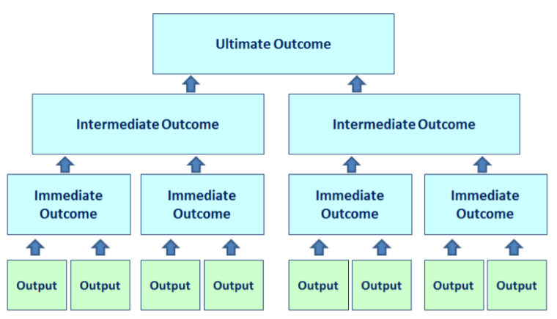
LOGIC MODEL
A logic model is a visual depiction of the theory of change for a specific project, reflecting the series of changes that are critical to achieving project outcomes. It depicts the logical connections between the planned outputs and the expected outcomes that the project aims to achieve or contribute to. The Logic Model’s pyramid structure enables us to illustrate the complex nature of a program or project. Different intermediate outcomes represent different “pathways” leading to the same ultimate outcome.
Notes:
At each level, an outcome statement describes the change your initiative wants to achieve, and different levels of change are expressed at different levels of the logic model.
IF ----- THEN
See the logic model guide in your resource pack - resource 10
Immediate outcomes describe a change in knowledge or skills
Intermediate outcomes describe a change in behaviour or actions
Ultimate outcomes describe a change in state or being
As we get higher in the logic model, we have less control over our contribution to the change.

Slide 40
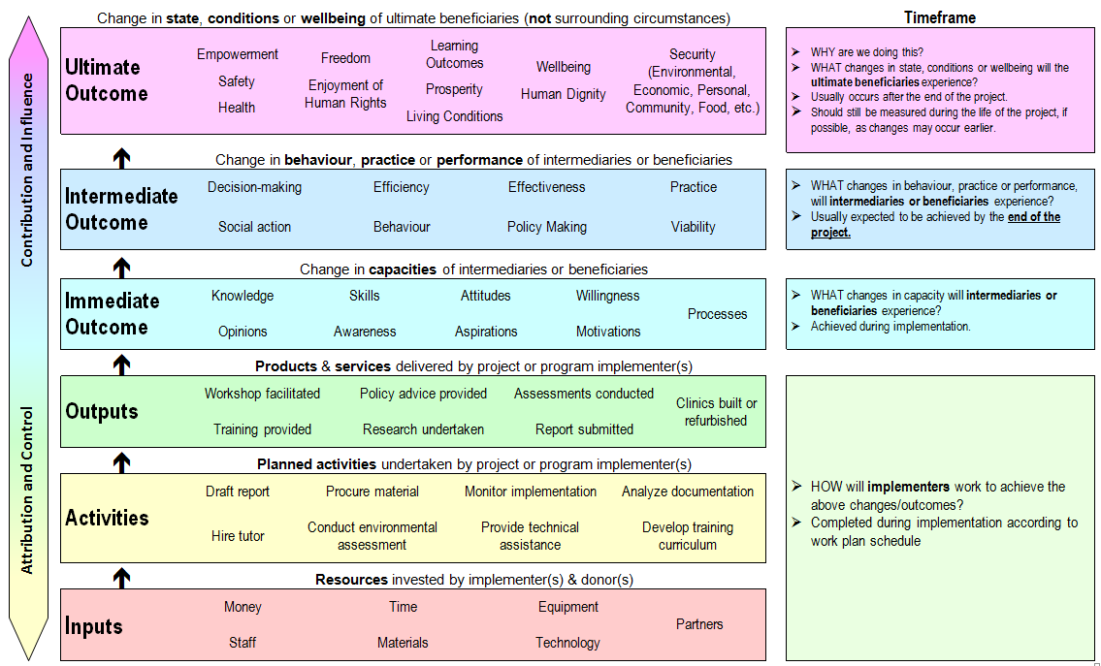

Slide 41
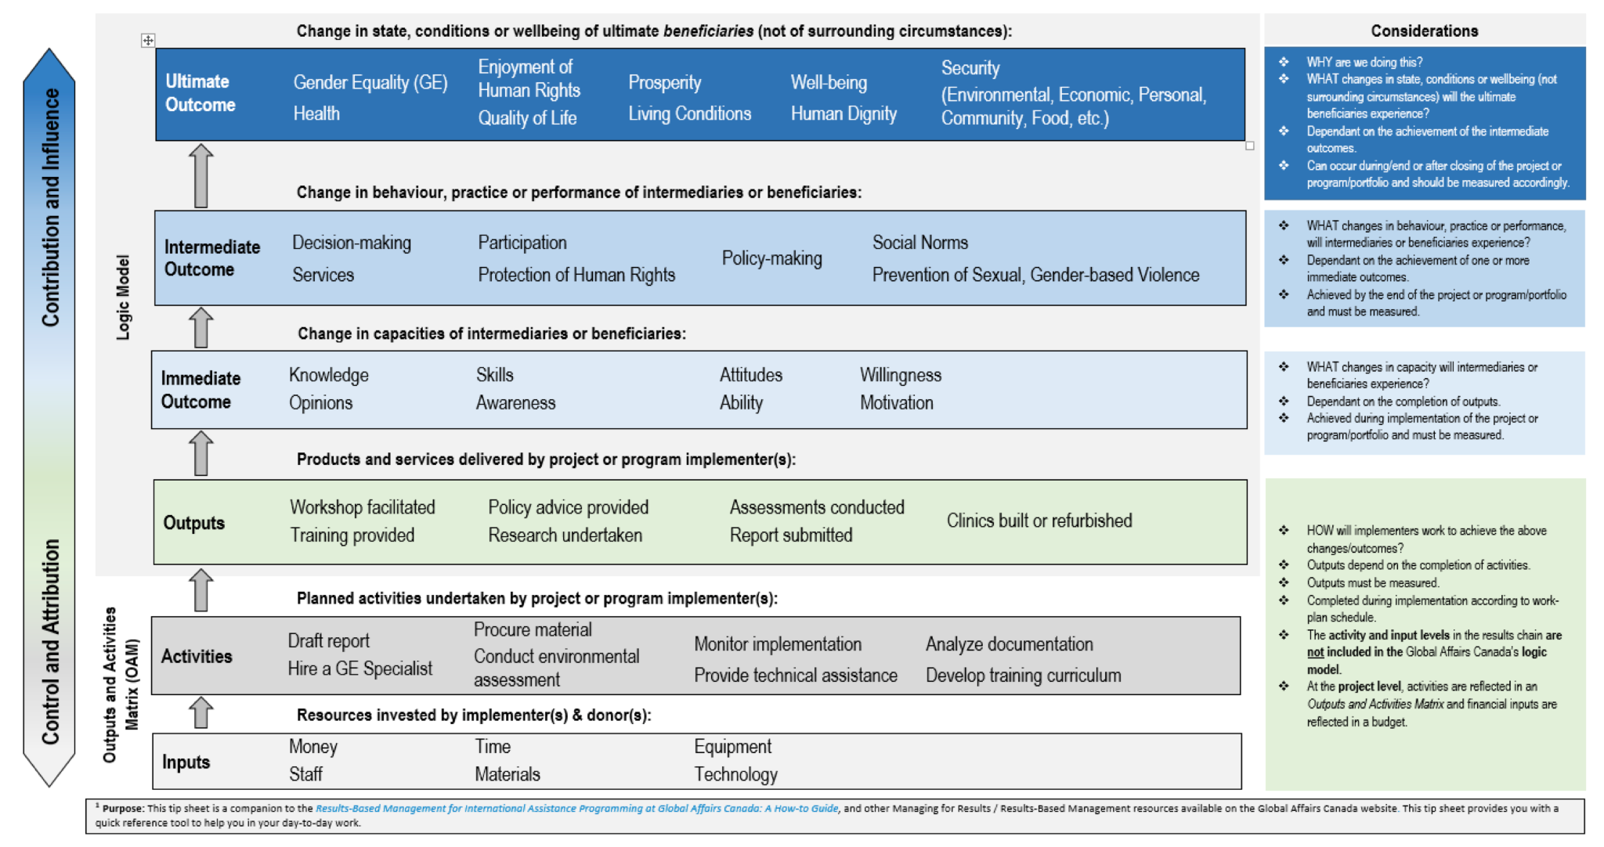

Slide 42
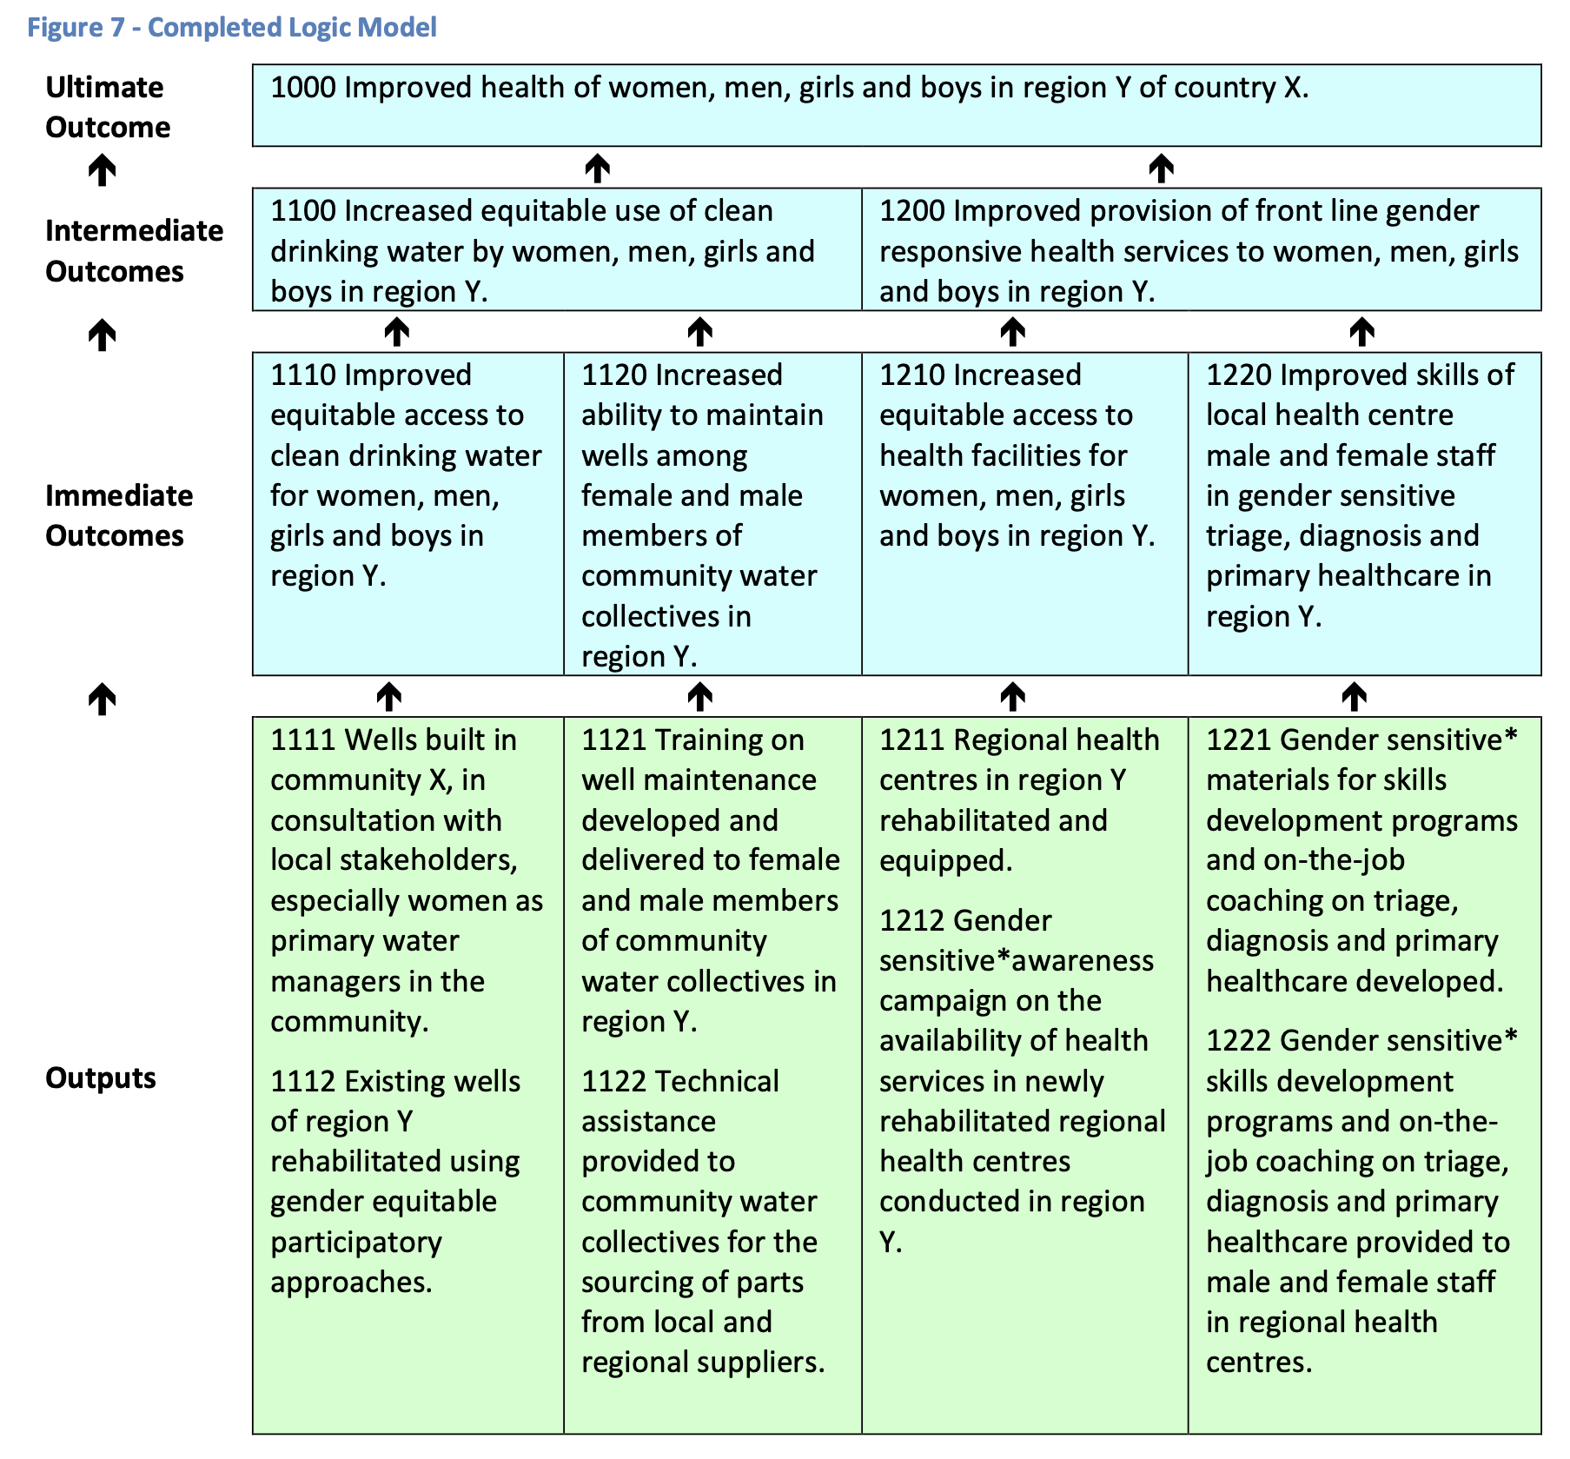

Slide 43
WHAT ELEMENTS
DOES A GENDER EQUALITY OUTCOME STATEMENT HAVE?
 | GE outcome statements explicitly describe an improvement or positive change related to gender equality.
 | GE outcomes statements do not merely refer to ‘women and men’ or add ‘including girls’ to the stated result.
Improved access, especially for adolescent girls, to nutritionally diverse food sources.
Increased decision-making power at the household level for adolescents, especially girls,
related to food purchasing and consumption.
Notes:
Note: there is some debate about whether adding ‘especially women’ to a result statement qualifies it as a GE outcome. In these cases, it may be more useful to look at the nature of the result itself and whether it has the potential to empower beneficiaries. For example, the latter of the two following statements may more effectively qualify as a GE outcome than the former because of the nature of the change it describes.

Slide 44
WHY IS THIS IMPORTANT THROUGHOUT THE LM?
Because it formalizes the intention of the project to affect positive change towards gender equality.
Because elements that are included in outcome statements determine the monitoring and evaluation design of a project, the budget of the project, and the management design of a project.

Slide 45
Activity 10.1: Logic Models
1
Go to Activity 10.1 in your Participant Resource Package where you will find detailed activity instructions. You will be moved back into your “Problem Trees” group from the earlier session.
Step
2
You will now take your problem tree analysis and build a logic model that describes a project or program to respond to your problem analysis. You have 30 minutes for this activity. You will be using a blank logic model created on Google Sheets (see Annex 10d)—you can find the links to your group’s Google Sheet and Problem Trees in your Participant Resource Package.
Step
You will find the Logic Model Handout (Annex 10c) to refer to in your Participant Resource Package.
Only focus on the top three levels of the LM: Ultimate Outcome, Intermediate Outcomes, and Immediate Outcomes—and then identify some activities for only one Immediate Outcome stream.
3
Step
Notes:
Reminder! The groups that they should not be concerned if their LM isn’t complete – it takes more time to design a good project! The value of this exercise is in the analysis, the discussion, and moving towards a greater understanding of how to strengthen gender equality within project design.
Remind participants that the facilitator will be “popping in” to their Zoom break-out groups to provide support, but if they need immediate attention there is a “help” button that they can hit to signal they need help immediately.

Slide 46
BUILD YOUR LOGIC MODEL
 | Keep in mind the lessons from Day 1: What is gender transformative change? How can the design reflect a human rights-based approach? How can the change be sustained – at the household, community and systemic level?
 | Begin with the Ultimate Outcome, then design toward that goal, level by level.
 | Assumptions about context, partners and scope will need to be made to fill in gaps. Typically, detailed research and consultations would be conducted, and budget or timeline parameters would be provided – so groups should agree on their assumptions in order to build their project design. Groups should not get too caught up on these missing pieces – rather they should focus on strong logic and design.
Notes:
Take 30 minute to build the logic model.

Slide 47
Session 11:
Implementation – Planning for transformative Change

Slide 48
Learning Objectives
To understand the implications (needs, challenges and risks) of gender transformative programming for key areas of implementation.

Slide 49
Key Messages
 | Achieving change in attitudes, social norms, and behaviours, takes time, skills and investment.
 | The risks of poorly implementing gender transformative programming cause unintentional harm to women and girls.
 | Supporting the implementation of gender transformative programming requires a collaborative effort between budget managers, program managers, and technical staff.

Slide 50
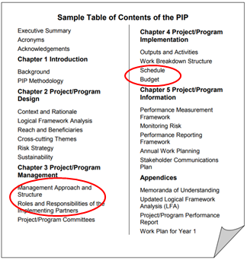
Implementing Gender Transformative Programs - The PIP
The Project Implementation Plan (‘PIP’) is the document created by an organization after a project has been approved. It asks the team to revisit and validate the original project design, to update and adjust as needed, and to create a detailed plan as how, when and with what resources each outcome will be achieved.

Slide 51
Considerations for Elements of Implementation Planning:
Needs, Risks and Challenges
Budget: What are some of the budgetary requirements and challenges in making sure this project is gender transformative?
Work Plan/Timeline: What kind of change is expected? How does that happen and how long does it take?
Human Resources: What are the skills needed? How can the project ensure sufficient skills to make sure the transformative objectives are achieved?
Notes:
Needs- what are the specific needs or unique needs for these programs related to resources: budget, time and human?
Challenges - what do we know about some of the challenges related to these three areas of implementation?
Risks - What are the risks? To program success? To beneficiaries and stakeholders?

Slide 52
Human Rights Principles
Equality and non-discrimination: All individuals are equal as human beings and entitled to human rights, without discrimination of any kind.
Participation and inclusion: All individuals are entitled to active, free, and meaningful participation in, contribution to, and enjoyment of civil, political, economic, social, and cultural development. The voices and interests of affected individuals are taken into account on issues that concern them and the development of their society.
Transparency and accountability: Individuals have access to information on policies, decisions and use of funds, and are empowered to hold those who have a duty to act accountable. State and non-State actors comply with their applicable obligations and responsibilities.
(GAC)
Notes:
Explain: a defining feature of a human rights based approach is that the realization of rights is not only at the core of the rationale for an intervention, but its principles must guide all stages of implementation.

Slide 53
Activity 11.1: Planning for Transformative Change
1
You will be moved into 4 different groups via Zoom breakout rooms.
2
Each group is assigned the same case study of a gender transformative program, found in Activity instructions 11.1 and Annex 11a in your Participant Resource Package.
3
In your groups, you will look at the activities within the case study, and pull out one of the activities that your group feels is strongly gender transformative. There may be more than one gender transformative element or activity, but choose one that feels really strong and clearly transformative.
4
Consider what it would take to deliver on that activity or element in a successful way - what kind of sub-activities and inputs will be needed? What kind of preparation, resources, relationships are needed?
Consider the following three elements of implementation planning (considerations will overlap - ie, HR requires budget, etc):
Workplan/timeline: What kind of change is expected? How does that happen and how long does it take?
Human Resources: What are the skills needed? How can the project ensure sufficient skills to make sure the transformative objectives are achieved?
Budget: What are some of the budgetary requirements and challenges in making sure this project is gender transformative?
In order to be truly gender transformative what are the time considerations, budget considerations and human resources considerations?
5

Slide 54
Activity 11.2: Refining our Logic Models
1
Go to Activity 11.2 of your Participant Resource Package where you will find detailed activity instructions. You will be moved back into your Problem Tree/Logic Model groups, as defined in your Participant Resource Package.
Step
As a group, you will have 30 minutes to further flesh out your Logic Models based on this session. You will find Global Affairs Canada’s Gender Equality Marker (Annex 11b) in your Participant Resource Package to help further refine your Logic Model.
Could your project be ranked with a high transformative value? How? If not, what changes could you make?
2
Step
3
Step
You will find all the related Mural Links and Google Sheet links in Activity 11.2 of your Participant Resource Package.
Notes:
Reminder! The groups that they should not be concerned if their LM isn’t complete – it takes more time to design a good project! The value of this exercise is in the analysis, the discussion, and moving towards a greater understanding of how to strengthen gender equality within project design.
Remind participants that the facilitator will be “popping in” to their Zoom break-out groups to provide support, but if they need immediate attention there is a “help” button that they can hit to signal they need help immediately.

Slide 55
Gender Equality Markers
Gender Equality Code | Explanation of GE coding:
GE-3 | Targeted - Gender equality is the principal objective of the initiative: The initiative was designed specifically to address gender inequalities and would not otherwise be undertaken. All outcomes in the logic model are gender equality outcomes.
GE-2 | Fully integrated -There is at least one intermediate gender equality outcome which will achieve observable changes in behaviour, practice, or performance that will contribute to gender equality.
GE-1 | Partially integrated - There is at least one gender equality outcome at the immediate outcome level which will achieve a change in skills, awareness, or knowledge that contributes to gender equality.
GE-0 | None - There are no gender equality outcomes.

Slide 56
Key Takeaways
Achieving change in attitudes, social norms, and behaviours, takes time, skills and investment.
The risks of poorly implementing gender transformative programming is the potential to cause unintentional harm to women and girls, and reinforce gender discriminatory norms.
Supporting the implementation of gender transformative programming requires a collaborative effort between budget managers, program managers, and technical staff.

Slide 57
Questions?

