Slide 1
Building Capacity and Confidence in Gender Transformative Programming: A Virtual Learning Experience
Module 3

Slide 2
Gender Transformative and Feminist MEAL
MODULE 3

Slide 3
Session 13:
MEAL:
From Gender Sensitive to Gender Transformative and Feminist

Slide 4
Learning Objectives
To understand that integrating and reflecting gender transformative and feminist approaches to MEAL exist on a spectrum, and can be applied to both process and outcome of MEAL activities.

Slide 5
Key Messages
 | Gender integration in MEAL activities must be comprehensive by addressing gender considerations in both process and purpose.
 | The spectrum builds on itself as it intensifies. For example, gender transformative monitoring activities will necessarily have the characteristics of gender sensitive and responsive monitoring activities.
 | Gender sensitive is the absolute bare minimum of gender integration that can be considered as good practice.

Slide 6
MONITORING is normally the systematic assessment of a programme’s performance over time. It involves the ongoing collection and review of data to provide programme managers and other stakeholders with indications of progress against programme plans and towards programme objectives.[1]
EVALUATION takes place at a particular point in time, but complements ongoing monitoring activities by providing more in depth, objective assessments of the relevance, efficiency, effectiveness, impact and sustainability of programmes. Formative evaluations are carried out during the life of the programme with a focus on improvement; summative evaluations take place towards the end of the programme and are used to judge its overall merit, worth or effectiveness.
ACCOUNTABILITY mechanisms include crucial information sharing to project or organization stakeholders about the delivery of services, the use of resources, and the achievement of outcomes. This includes project donors, partners and beneficiary or participants communities. Accountability to government or donors is sometimes referred to as ‘upward accountability’, accountability mechanisms targeting beneficiary groups or communities is referred to ‘downward accountability’, and ‘horizontal accountability’ refers to sharing and learning activities with partners, colleagues, peer organizations and stakeholders.[2]
LEARNING activities are deliberate efforts to use project data (qualitative/quantitative/formal/informal/observational) to reflect on and improve upon programmatic and operational approaches. This often involves specific research initiatives.
MEAL
Notes:
[1] Oxfam GB: A Quick Guide to Monitoring, Evaluation, Accountability and Learning in Fragile Contexts (no date)
[2] Note that some participants may rightly observe that the terms ‘upward’ and ‘downward’ accountability employ a language of hierarchy that implies an associated importance which would be interrogated and rejected by many feminist approaches.

Slide 7
GE Integration
Low GE Integration
High GE Integration
 | Gender Aware/Sensitive | Gender Responsive | Gender Transformative / Feminist
Monitoring
Evaluation
Accountability
Learning

Slide 8
GE Integration
 | Gender Aware/Sensitive | Gender Responsive | Gender Transformative / Feminist
Monitoring | Monitors female and male beneficiaries and stakeholders Takes gender into consideration during planning and risk analysis for data collection Captures and organizes data disaggregated by sex/age | Monitors female and male beneficiaries and stakeholders Takes gender into consideration during planning and risk analysis for data collection Captures and organizes data disaggregated by sex/age Monitors gender-based differences between participation in and benefit from intervention Ensures meaningful participation of women and girls in monitoring activities | Monitors female and male beneficiaries and stakeholders Takes gender into consideration during planning and risk analysis for data collection Captures and organizes data disaggregated by sex/age Monitors gender-based differences between participation in and benefit from intervention Ensures meaningful participation of women and girls in monitoring activities Co-designs monitoring activities with women and girl participants Ensures the use of monitoring tools that capture individual and experiential data Uses monitoring activities that are empowering in and of themselves

Slide 9
DIG IN!
What do you see as you move across the spectrum towards greater intensity of gender integration?
What are some of the practical implications to consider as you move towards greater intensity of gender integration?

Slide 10
Activity 13.1: MEAL across the GE Spectrum
1
Step
Go to Activity 14.1 in your Participant Resource Package where you will find detailed activity instructions.
2
Discuss what characteristics your MEAL component would have if taking a gender aware/sensitive approach, a gender responsive approach, and a transformative/feminist approach.
Step
3
Step
Take 20 minutes and return to plenary.
Notes:
Gallery view

Slide 11
Key Takeaways
Gender integration in MEAL activities must be comprehensive by addressing gender considerations in both process and purpose.
The spectrum builds on itself as it intensifies. For example, gender transformative monitoring activities will necessarily have the characteristics of gender sensitive and responsive monitoring activities.
Gender sensitive is the absolute bare minimum of gender integration that can be considered as good practice.

Slide 12
Session 14:
Quality Indicators for Gender Equality Outcomes

Slide 13
Learning Objectives
To understand how to construct and select quality indicators to support gender equality outcomes and gender transformative programming

Slide 14
Key Messages
 | Indicators are a signal of change, and need to effectively respond to the level of change in project outcomes; they MUST be gender sensitive as a minimum level of gender equality integration
 | Gender transformative change refer to changes in social behaviours and attitudes (position, not just condition), and therefore requires a combination of indicators that must include qualitative indicators

Slide 15
Performance Measurement Framework
Expected Result | Indicator(s) | Baseline Data | Targets | Data Sources | Data collection Methods | Frequency | Responsible
Outcome or Results Statements | What is being measured? | Where you are starting from? | Where will you end up? | Where or who is the data coming from? | How is it being collected? | How often is this data being collected? | Who is collecting the data?

Slide 16
What is an indicator?
An indicator is a signal that shows change has happened.
Every indicator has 3 building blocks:
There are 2 types of indicators:
Quantitative Indicator:
Used to measure quantities or amounts
They are objectively verifiable.
For example: temperature, distance, middle upper-arm circumference, death rate, but also individual knowledge and skills.
Qualitative Indicator:
They are subjective
They capture experiential information, such as the quality of something, or beneficiaries perception of their situation, their opinion or preferences
They also would measure an individual’s perception of their own knowledge or skills
The unit of measure is the number, percentage, level, ratio, etc.
The unit of analysis is who or what will be observed: individuals, institutions, social artifacts or social groups.
The context is the set of circumstances that specify the particular aspect of the output or outcome that the indicator is intended to measure.

Slide 17
Identify the specific aspects of the indicators in the table that make them gender sensitive:
Unit of Measure | Unit of Analysis | Context
#/total | Adolescent girls and boys aged 15-19 (disaggregated by rural/urban setting) | Who have attended a health clinic in the past 12 months.
Level of confidence | of male partners of women of child-bearing age | in the privacy provided during family planning counselling
%/total | health institutions (public/private) | providing gender sensitive services to ethnic populations in their language of choice
Degree of support | Amongst adult males | For women’s engagement in work outside the home
%/total | of individual citizens trained (disaggregated by sex, age, and provinces) | reporting change in media consumption habits one month after participating in the propaganda-proof training
# | of policy proposals passed | that create conditions for national reconciliation in conflict zones
Ratio | of women to men | in decision-making positions in the government
Notes:
an indicator should be neutral – meaning that it does not indicate a direction of change

Slide 18
What is an indicator?
An indicator must always be developed or selected to effectively capture the level of change of a result (tranformative/aware/etc.), and must ALWAYS be gender sensitive, regardless of the level of change. Gender sensitive is the minimum level of gender integration.
What do we mean by this?
When we talk about gender transformative results, in order to be effective, we want to measure changes in attitudes and perceptions about the value of women and girls and their agency and decision making. Most outcomes have multiple indicators and will include some that are quantitative and some that are qualitative.
Gender sensitive indicators do the following:
Disaggregate by sex and age
Disaggregate by other relevant factors of intersectionality
Use language that describes in gendered detail the unit of analysis
Use language that includes gender-related elements of the context

Slide 19
In order to respond to this outcome, would we want to measure only the rate of usage of contraceptives by adolescent girls?
“Increased empowerment of adolescent girls to claim their right to safe and accessible contraceptive services and resources.”
NO
... in fact, we also must measure whether that right is being realized – which requires us to measure their agency in the decision to use contraceptives. Usage rates alone do not tell us about an adolescent girl’s empowerment.

Slide 20
How can we measure complex concepts like AGENCY, CHOICE and EMPOWERMENT?
Asking participants directly about their empowerment, agency, choice.
Using an indicator that suggests empowerment/agency, sometimes known as ‘proxy’ indicator.
Using a composite indicator or index to measure the multi-dimensional aspects of empowerment and agency.
Notes:
Participants might come up with three possibilities – if not, introduce the following:
1. Asking beneficiaries directly about their empowerment, agency, choice.
2. Using an indicator that suggests empowerment/agency, sometimes known as a ‘proxy’ indicator
3. Using a composite indicator or index to measure the multi-dimensional aspects of empowerment and agency.
A direct question about empowerment would have participants indicate whether they have experienced empowerment. For example: ‘Do you feel empowered with respect to decisions related to your reproductive health?’. Self-reporting the experience of complex and multi-dimensional phenomena like empowerment or agency can be problematic for a couple of reasons: it assumes that the respondent has a shared understanding of the meaning of the concept; it assumes that the respondent sees no risk or benefit to responding positively or negatively to a question of their own empowerment or agency; it assumes that their understanding of that concept will have remained the same over a period of time.
A ‘proxy’ indicator is an indicator that is used in place of a direct measurement. Much like it sounds, it ‘approximates’ or represents a phenomenon or occurrence. For example, increased income is often used as a ‘proxy’ for economic empowerment. The assumption is that increased income suggests that economic empowerment has taken place. However, proxy indicators can be problematic when it comes to elements of control and choice. In the case of economic empowerment, it is important to understand other elements of agency and empowerment related to the increased income: for example to understand whether she is able to choose how the increased income is spent, whether the increased income was gained through exploitative practices, whether earning the increased income was her choice, and whether it has improved her wellbeing or merely added to her burden of work and vulnerability.
A composite indicator or index aggregates multiple elements to create a single measurement for complex, multi-dimensional phenomena. These indicators can be composed of multiple quantitative and qualitative sub-indicators. For example, a composite index used to measure women’s economic empowerment might include elements that measure their increased income, their decision-making role in household expenditures, and changes in their burden of unpaid household labour and care. The advantages of a composite indicator or index are many: it can be designed in response to specific context, project design and priorities; the sub-indicators or domains can usually be disaggregated and provide a deeper and more insightful understanding of the change (or lack of change) that is occurring; and most importantly, it affords the space to explore these multi-dimensional aspects of agency and empowerment. Disadvantages may include the fact that the development and analysis of composite indicators requires a higher level of technical skill, that the complex nature of its design means that a newly designed composite should be tested before applied, and the design usually involves assigning weights and thresholds, which can embed bias and assumptions into the tool and the calculation of results. In addition, a composite indicator or index can require a more lengthy tool or data collection process because it reflects multiple dimensions, which have time and budget implications.

Slide 21
Activity 14.1: Quality Indicators for GE Outcomes
1
Step
Go to Activity 15.1 in your Participant Resource Package where you will find detailed activity instructions.
2
Using the logic model and outcome statements created yesterday, you are to develop quality indicators for one immediate and one intermediate outcome that capture gender equality changes in an effective way with your problem analysis groups.
Step
3
Step
You have 30 minutes to think of your indicators with your groups.
Notes:
An outcome can have multiple indicators! For example, an outcome related to improved sexual and reproductive health could have an indicator on reduced teenage pregnancy rates, increased household decision making, and reduced incidents of sexual and gender-based violence.
There are no PERFECT indicators – and this is not an M&E training. Groups should focus on capturing the gender transformative change they’ve described in their outcome statements.

Slide 22
Key Takeaways
Indicators are a signal of change, and need to effectively respond to the level of change in project outcomes; they cannot be gender transformative but MUST be gender sensitive as a minimum level of gender equality integration
Gender transformative change refer to changes in social behaviours and attitudes (position, not just condition), and therefore requires a combination of indicators that must include qualitative indicators

Slide 23
Session 15:
Data Collection Tools and Methodologies for Gender Equality Indicators

Slide 24
Learning Objectives
To understand how feminist principles and gender transformative programming can be reflected and promoted in data collection design.

Slide 25
Key Messages
 | The voices of gender marginalized people is essential for the measurement of gender transformative change and to align with feminist approaches to MEAL
 | There is a wide variety of data collection tools that can effectively respond to indicators, and all have the potential to challenge power dynamics, align with feminist principles, and contribute to the measurement of transformative change – depending on the process of their use.

Slide 26
Performance Measurement Framework
Expected Result | Indicator(s) | Baseline Data | Targets | Data Sources | Data collection Methods | Frequency | Responsible
Outcome or Results Statements | What is being measured? | Where you are starting from? | Where will you end up? | Where or who is the data coming from? | How is it being collected? | How often is this data being collected? | Who is collecting the data?

Slide 27
Data Sources & Collection Methodologies
Which methodologies would be more effective for gathering data related to gender transformative change?
Which methodologies would be more aligned with feminist principles? Why?
Data Collection Methods
Conversation with concerned individuals
Most significant change
Field visits/observation
Transect walk
Critical reviews of official records or other documents
Individual and key informant interviews
Focus group discussions
Guided observation
Official records/secondary data
Surveys
Census
Scientific research
Data Sources
Primary:
Participants (individuals)
Intermediaries
Secondary:
Demographic health survey data
Human development report
Global Peace Index
Peer reviewed research
Reports from community of practice
Notes:
Qualitative and less formal or structure methodologies are often associated with a feminist approach or feminist principles, they are thought to be:
more participatory,
more likely to acknowledge and challenge the power dynamic between data collector and subject,
And more effective at capturing individual and subjective experiences
There are also those who feel that the characterization of formal, rigorous methodologies as less ‘feminine’ or feminist is in itself a way of creating false dichotomies
Best practice tells us the at the strongest MEAL systems will use a mixed-method approach which employs both quantitative and qualitative data to measure changes in state, and use those to triangulate and build a deeper understanding of change

Slide 28
Activity 15.1 Data Sources and Methodologies
1
Step
Go to Activity 15.1 in your Participant Resource Package where you will find detailed activity instructions.
2
In your problem analysis groups, you will have 20 minutes to identify the data sources and methodologies for your project’s indicators.
Step
3
Step
Be prepared to share one or two examples in plenary.
Notes:
Gallery view

Slide 29
Key Takeaways
The voices of gender marginalized people is essential for the measurement of gender transformative change and to align with feminist approaches to MEAL
There is a wide variety of data collection tools that can effectively respond to indicators, and all have the potential to challenge power dynamics, align with feminist principles, and contribute to the measurement of transformative change – depending on the process of their use.

Slide 30
Session 16:
Accountability - data for whom?

Slide 31
Learning Objectives
To introduce and explore different approaches to accountability and how sharing data and learning can be gender transformative and strengthen programming.

Slide 32
Key Messages
 | Good accountability and learning practices should include mechanisms for upward accountability, downward accountability and horizontal accountability that reflect gender equality considerations
 | From a rights-based and feminist perspective, beneficiaries (or participants) themselves must be equal owners of the data (by having access to it, understanding it, contributing to its analysis and use).

Slide 33
GROUP DISCUSSION
Data for what purpose?
Data for whom?
What do we use data for?
To understand progress
To improve programming
To communicate progress
To be accountable for achievement of outcomes
Notes:
This slide has animation - the definitions fade in on click

Slide 34
Accountable
Obligated to explain, justify, and take responsibility for one’s actions, and to answer to someone.
- Dictionary.com
Notes:
Accountability mechanisms include crucial information sharing to project or organization stakeholders about the delivery of services, the use of resources, and the achievement of outcomes.
This includes project donors, partners and beneficiary or participants communities.
Accountability to government or donors is sometimes referred to as ‘upward accountability’, accountability mechanisms targeting beneficiary groups or communities is referred to ‘downward accountability’, and ‘horizontal accountability’ refers to sharing and learning activities with partners, colleagues, peer organizations and stakeholders.[1]

Slide 35
Upward Accountability: donors, sponsors, clients, government, taxpayers
Horizontal Accountability: community of practice, peer organizations/institutions, stakeholders, members of gender equality and feminist movements, cluster members
Downward Accountability: beneficiaries/participants; community members
Notes:
MURAL link: https://app.mural.co/t/genderequalitytrainingmodule9832/m/genderequalitytrainingmodule9832/1604985135708/7d3e51ad1ce2cb954c7edc6a3323af200e7f2ba7

Slide 36
Why is this level of accountability important in gender transformative programming?
How can we use our donor reports to advocate for women’s empowerment & rights-based approaches?
What is it that we report on? What do we highlight? How do we present our data?
UPWARDS ACCOUNTABILITY
Why is this level of accountability important in gender transformative programming?
How can horizontal accountability reflect and promote feminist principles?
How can horizontal accountability improve gender transformative programming?
HORIZONTAL ACCOUNTABILITY
Why is downward accountability important? Why specifically for gender transformative programming?
What are the benefits? For whom?
Do we do it enough? Why not?
DOWNWARDS ACCOUNTABILITY
Notes:
If we agree it is incredibly important – HOW do we do it? And in particular, how do we do it in a meaningful way: linked to feminist principles, and an empowering experience in and of itself for participants. Ask participants to share their experiences with downward accountability, including successes and challenges. Take about 10 minutes for this discussion.

Slide 37
Activity 16.2: Case study!
1
Step
Go to Activity 16.2 in your Participant Resource Package where you will find detailed activity instructions.
2
Based on the group assignments listed in your Participant Resource Package, you will be discussing the case study found in Annex 16a.
Step
You will have 20 minutes to discuss the following:
How are these examples empowering participants?
What gender and intersectionality considerations would need to be included in this methodology?
What are the implications for implementation (HR, timeline, budget)?
3
Step
Notes:
Gallery view

Slide 38
Key Takeaways
Gender transformative programming should always reflect a rights-based approach; but we must also understand the instrumentalist rationale for gender equality programming.
A human rights based approach to programming demands that human rights are the core rationale for any intervention, but it also demands that human rights principles guide all stages of implementation.

Slide 39
Questions?

Slide 40
Additional Session
Gender-Based Analysis

Slide 41
Learning Objectives
Participants will have a stronger understanding of the foundational components of gender analysis and confidence to approach the planning and design of a gender analysis.

Slide 42
Key Messages
 | Gender analysis provides essential information to inform gender transformative programming and implementation.
 | Gender analysis can build on existing frameworks and should be tailored to the needs of your initiative.
 | Gender analysis should happen throughout the project cycle and can be conducted by any organization.

Slide 43
Understanding Gender Analysis
WHAT?
What do we analyze in a gender analysis?
HOW?
How do we conduct a gender analysis?
WHEN?
When do we conduct gender analysis?
WHO?
Who should conduct a gender analysis?

Slide 44
WHAT?
What do we analyze in a gender analysis?
What data do you collect?
What do we analyze?
Who does what? Roles, responsibilities, expectations… why?
Who has what? Resources, opportunities, power…. why?
Who decides what? In the household...community… government… why?
Who gains? Who loses?
Who has conducted a gender analysis?

Slide 45
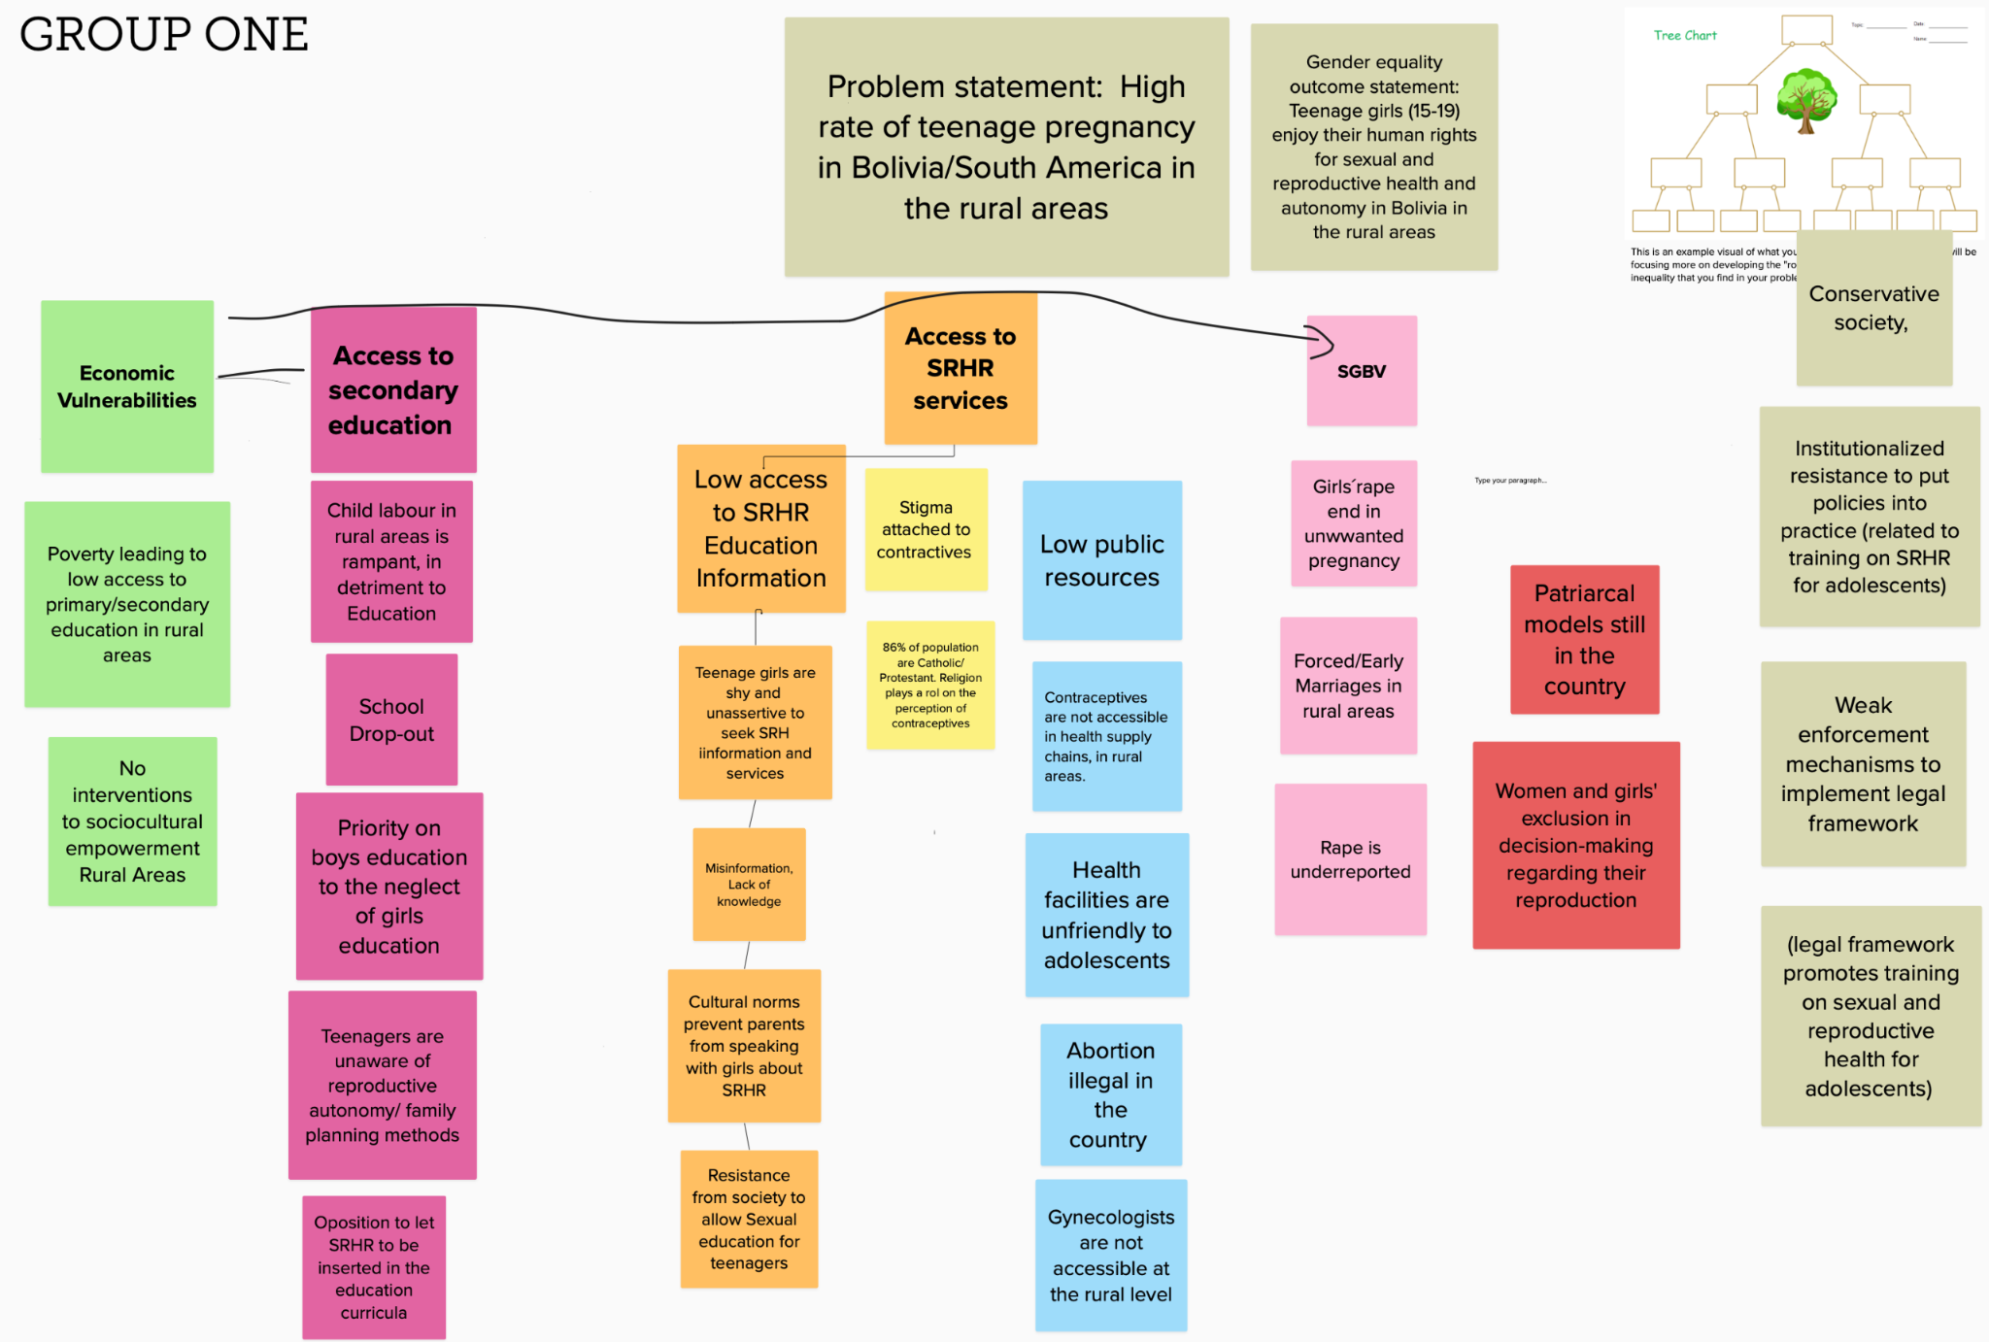
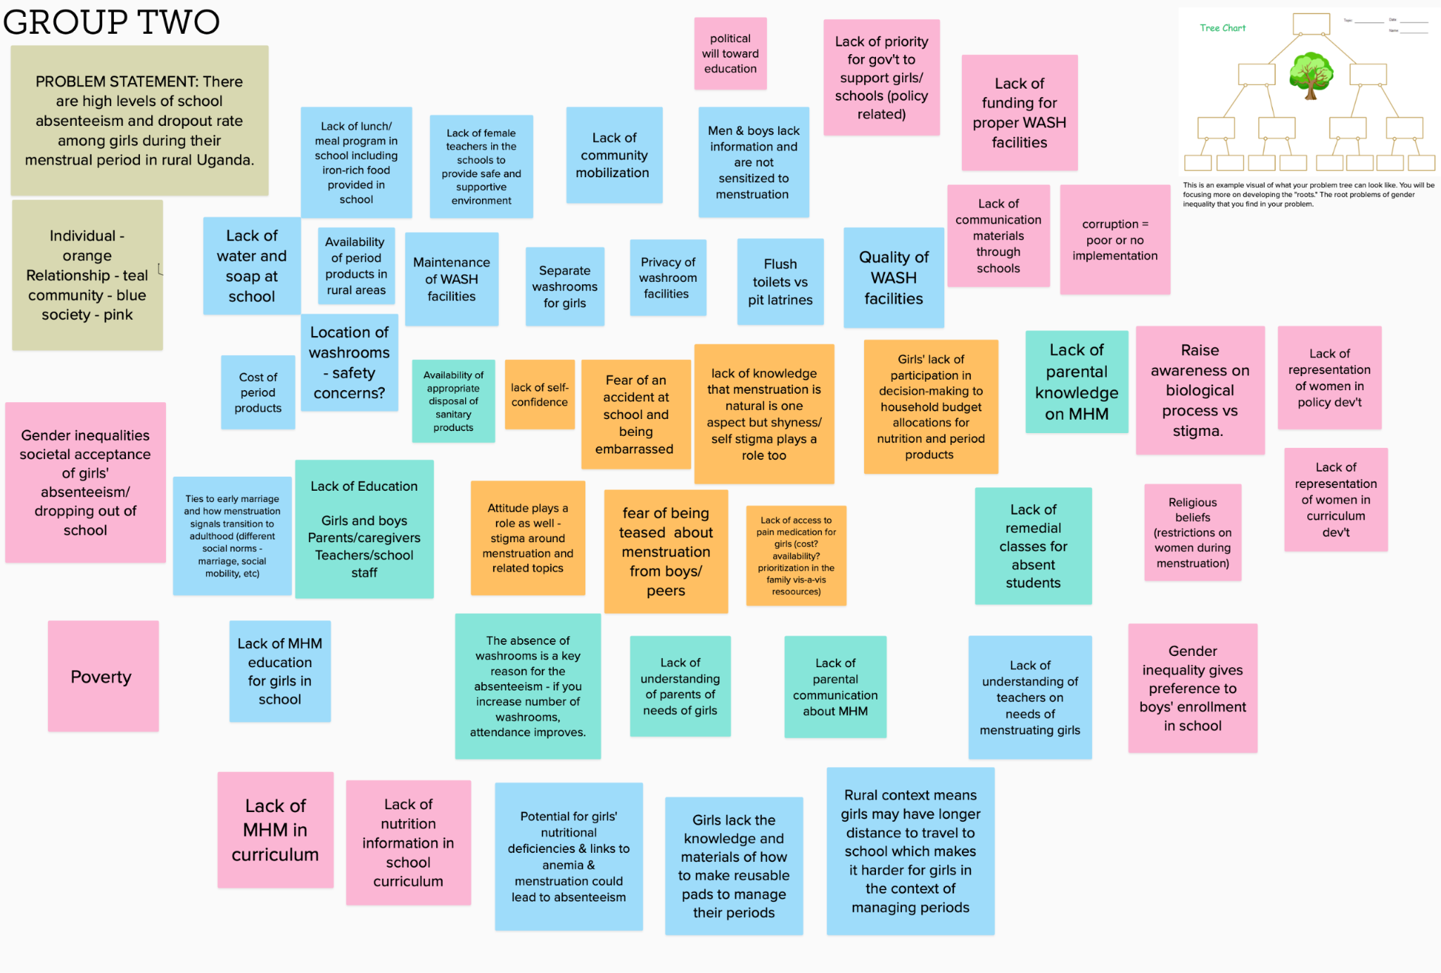
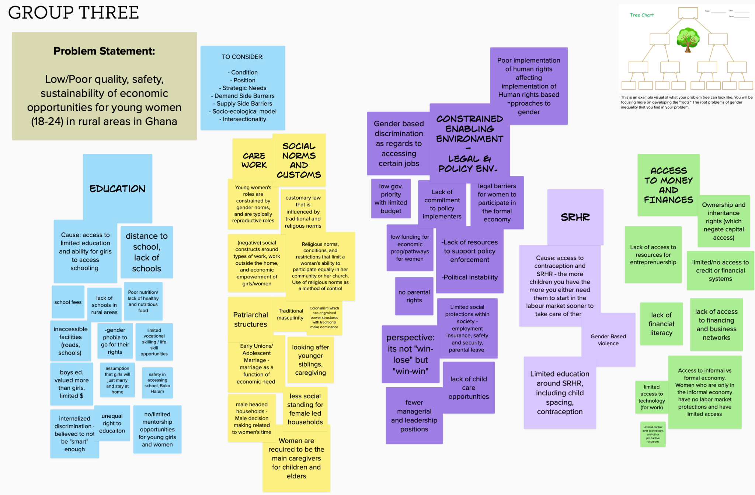

Slide 46
Gender Analysis Frameworks
Gender Analysis Frameworks provide step-by-step methodologies for conducting gender analysis. A thorough gender analysis should reflect the ways in which all other cross-cutting issues (age, environment, ethnicity, rights) also impact on women, men and gender diverse people.
Common domains you will often see used by various organizations and institutions pull from all these frameworks, and might include:
Roles & Responsibilities
Social norms/gender norms
Participation and decision making
Access to/control over resources
Systemic/
institutional norms

Slide 47
Global Affairs Canada’s GBA+
Global Affairs Canada defines Gender-based analysis (GBA+) as an analytical process used to assess how diverse groups of women, men and non-binary people may experience policies, programs and initiatives.⁶ The “plus” in GBA+ acknowledges that GBA+ goes beyond biological (sex) and socio-cultural (gender) differences. GBA+ considers many identity factors, such as race, ethnicity, religion, age, and mental or physical disability.

