Slide 1
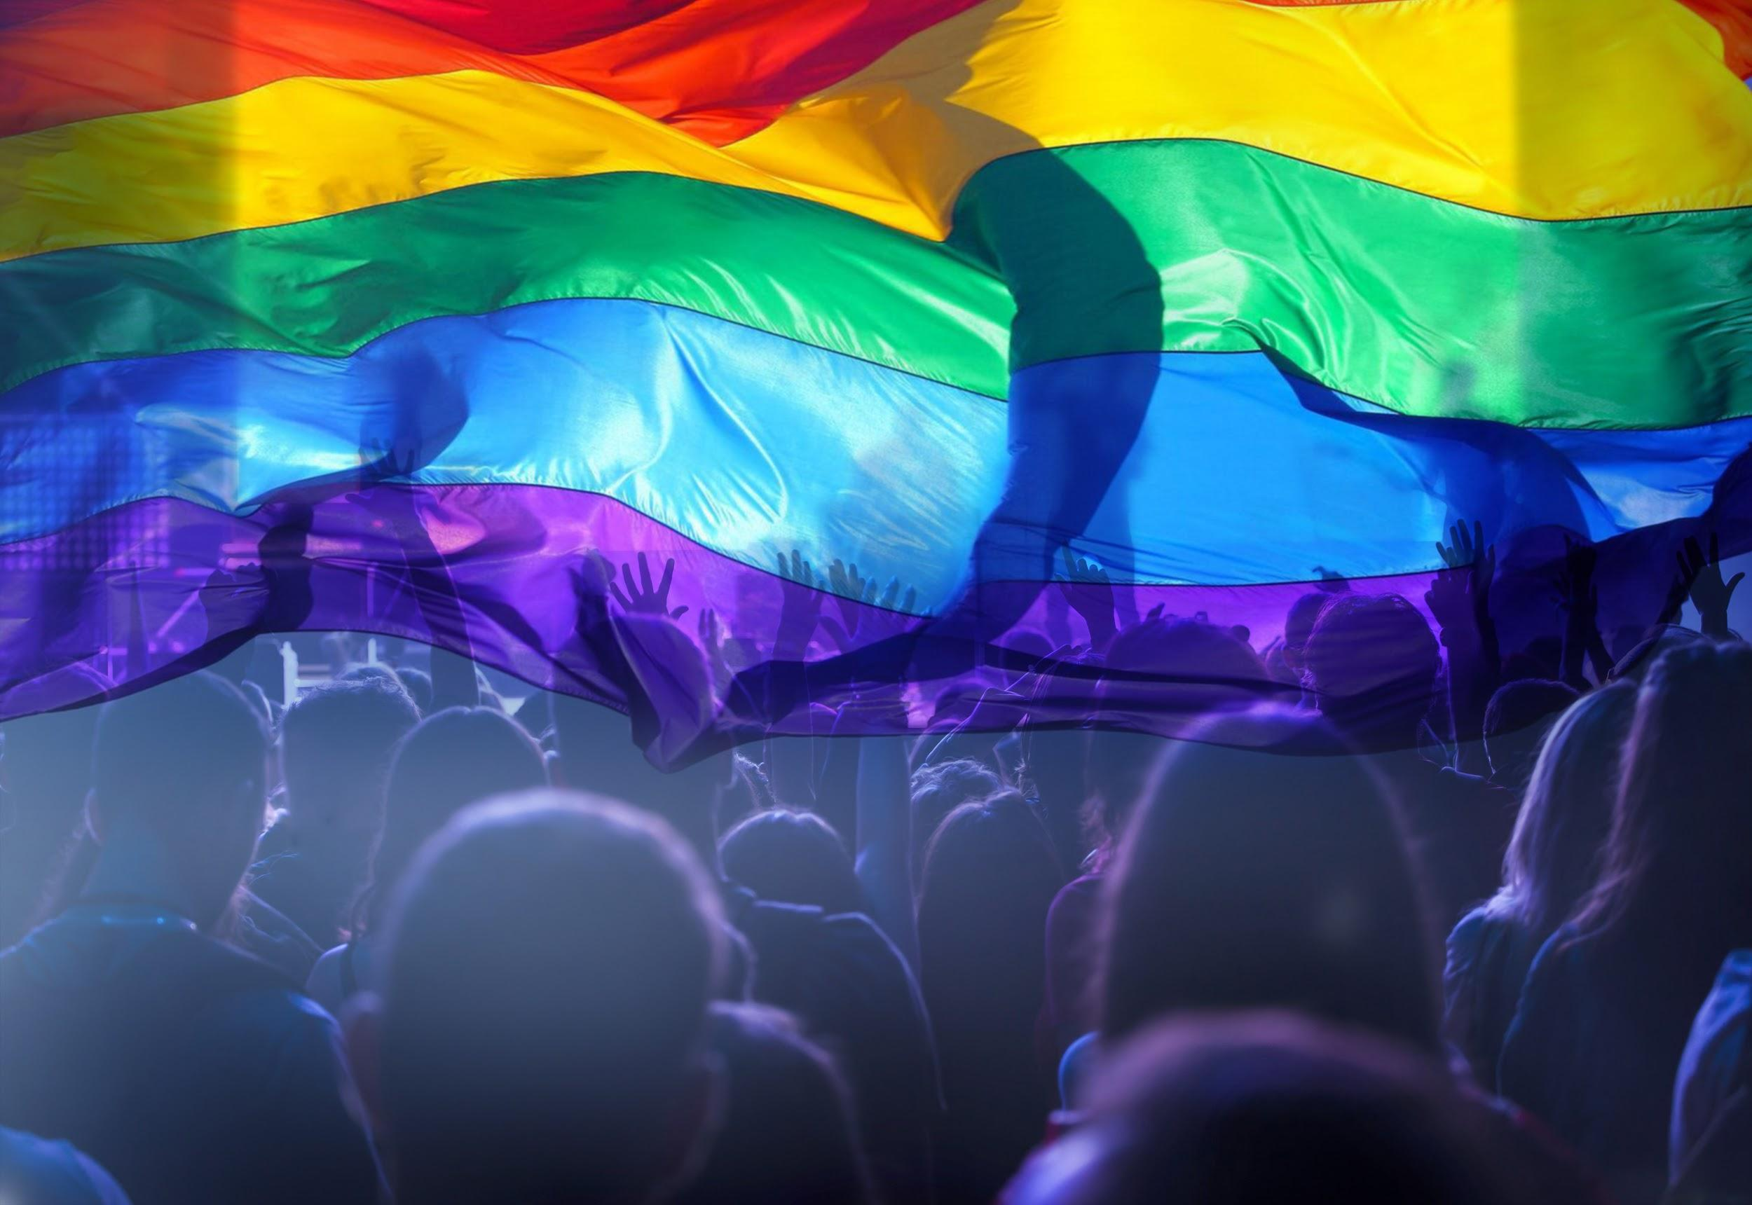
Building Capacity and Confidence in Gender Transformative Programming: A Virtual Learning Experience
Module 1

Slide 2
Session 1:
Introduction

Slide 3
Session 1: Learning Objectives
Familiarity with the overall training objective.
Familiar with the instructor(s) and other participants.
Establishing a safe and respectful space for sharing and learning.

Slide 4
Overall Training Objective
This training program is about strengthening the confidence and capacity for both gender equality experts and non-experts in the application of gender transformative programming in women’s and children’s health.

Slide 5
TRAINING MODULES
 | MODULE 1: Gender Equality Concepts and Terminology Participants will have increased familiarity with, and confident use of key concepts and terminology related to gender equality.
 | MODULE 2: Elements of Gender Transformative Programming Participants will strengthen their understanding of and ability to practically support the design of gender transformative programs and initiatives.
 | MODULE 3: Gender Based Analysis and Monitoring and Evaluation Participants will be introduced to key accountability tools for Gender Transformative Programming, and will understand how they can be used in their own work.

Slide 6
Goal Setting
Let’s set some goals!
In your own notes, take a few minutes to set a couple goals for yourself about how you would like to participate over the next few days.

Slide 7
TRAINING PRINCIPLES
Participation: Each one of you brings a wealth of experience to the program. Participate fully and give everyone a chance to contribute, encouraging others to do so.
Respect Others: Respect each other, yourselves, and the trainer. Do not speak when someone else is speaking. Listen actively.
Support an inclusive environment: Support an environment of inclusion and respect diversity in all its forms. Discrimination or exclusion of any kind will not be accepted.
Agree to Disagree: Feel free to express opinions and concerns. Everyone should contribute to a safe/non-judgemental environment.
Punctuality: Arrive on time to each workshop session. Arriving late is a sign of disrespect to the trainer and to your fellow participants.
Minimize Disturbances: Cell phones should be turned off at the beginning of the workshop and remain off until the end. Avoid side conversations and please ask the facilitator to clarify.
Ask Questions: There are no stupid questions. If you do have a question you don’t want to ask in front of others, ask it privately during a break. Please do not think any question you have is unimportant.

Slide 8
Concepts & Terminology
MODULE 1

Slide 9
Session 2:
Gender 101

Slide 10
Learning Objectives
To understand and feel confident using basic terminology and definitions related to gender.

Slide 11
Key Messages
 | Terminology is a ‘tool, not a rule’: use it to understand not undermine
 | This section might be a refresher for you or an introduction of key terms and their meanings; basic gender terminology will be introduced to establish a shared understanding that will align and guide us through the rest of the training program
 | Terminology will vary across the sector in different ways (and in different languages), and having a strong foundational understanding can help navigate those differences.

Slide 12
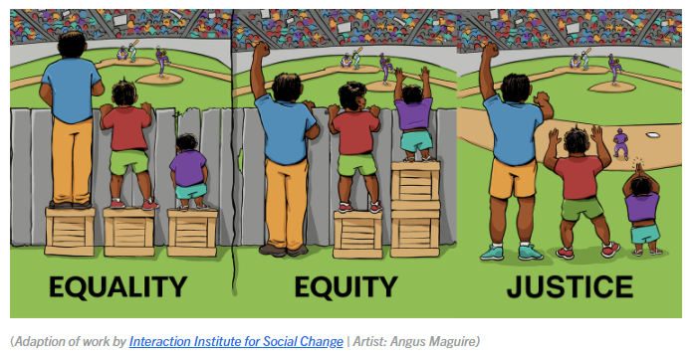
Equity/Equality
https://medium.com/@eec/this-equity-picture-is-actually-white-supremacy-at-work-59f4ea700509

Slide 13
Terminology and Concepts
Feminist
Gender
Exploitative
Gender Responsive
Gender
Transformative
Gender Aware
Gender Unaware
Gender Sensitive
LOW IMPACT
HIGH IMPACT

Slide 14
Key Takeaways
Terminology is a ‘tool, not a rule’
Basic gender terminology establishes a shared understanding
Terminology varies across the sector

Slide 15
Session 3:
Gender Equality and Change
Understanding Transformative Change

Slide 16
Learning Objectives
To gain a deeper understanding, beyond terminology, of gender equality concepts.

Slide 17
Key Messages
 | Learning terminology is just one part of the skills needed to advance gender equality in your programming, this session will help participants understand the concepts behind the change you are proposing/supporting.

Slide 18
Gender
Transformative
Change
Gender transformative change is defined as a deep structural change achieved by addressing the root causes of gender inequality.
UN: Economic and Social Commission for Western Asia.

Slide 19
DIG IN!
How do these concepts have
a relationship to power?
Power over
people, resources and decisions
Power to
act and to realize one’s aspirations
Power with
others that comes out of cooperation and collaboration.
Power within
that comes from a sense of self-worth and self-knowledge
How could you use this concept to explain gender transformative change?
What would be some practical examples that illustrate these concepts in real-world projects?
Access to resources vs control over resources
Practical vs Strategic Needs
Condition vs Position

Slide 20
Terminology and Concepts
Feminist
Gender
Exploitative
Gender Responsive
Gender
Transformative
Gender Aware
Gender Unaware
Gender Sensitive
LOW IMPACT
HIGH IMPACT
Increased Access of Resources
Increased Control of Resources
Practical Needs
Strategic Needs
Changes in Condition
Changes in Position

Slide 21
Key Takeaways
Learning terminology is one part of the skills needed to advance gender equality in your programming - but understanding concepts is equally as important!

Slide 22
Session 4:
Gender Diversity

Slide 23
Learning Objectives
Understand the complexities and diversity that exists within and around gender, with a deeper look into identities that fall outside of the binary understanding of gender and how this can be applied to our work.

Slide 24
Key Messages
 | Exploring factors of diversity within and around gender will help participants move towards an understanding of intersectionality and of gender as non-binary
 | The diversity of gender expression and sexual identity is global, and work towards gender equality should reflect the rights and experiences of these groups.

Slide 25
LGBTQ is the more commonly used term in the community.
You may also hear the terms ”Queer Community” or “Rainbow Community” used to describe LGBTQ2+ people.
The initialism and the various terms are always evolving, the most important thing is to be respectful and use the terms that people prefer.
https://egale.ca/wp-content/uploads/2023/07/2SLGBTQI-Terms-and-Definitions-2.0.pdf

Slide 26
Unpacking Non-binary Gender Identity
Source: https://transstudent.org/gender/

Slide 27
Refer to Annex 4d for: “PEW Research Center’s June 2020 Report: The Global Divide on Homosexuality Persists: But increasing acceptance in many countries over past two decades” This resource shows a growing acceptance of gender and sexual diversity, especially amongst educated and younger populations.
As with rights of women and girls, the movement for greater recognition and protection of 2SLGBTQI+ rights is growing around the world.

Slide 28
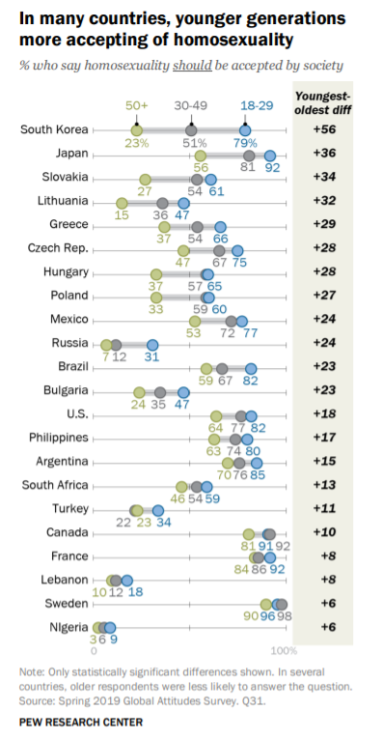
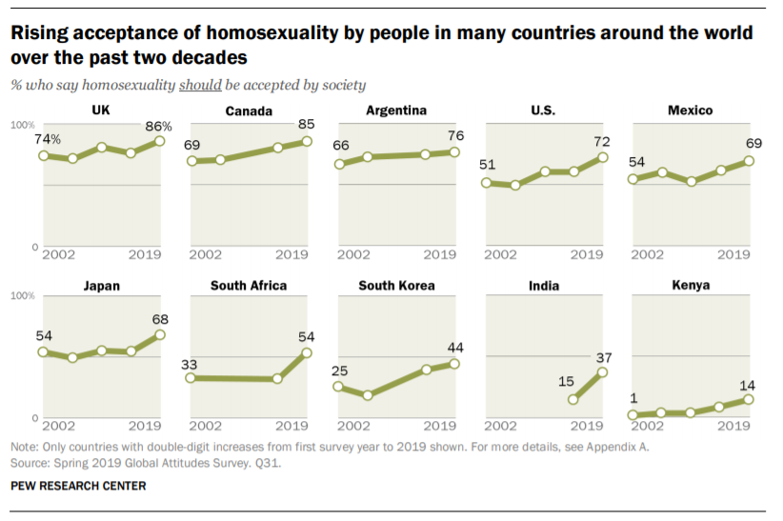
Source: https://www.pewresearch.org/global/wp-content/uploads/sites/2/2020/06/PG_2020.06.25_Global-Views-Homosexuality_FINAL.pdf

Slide 29
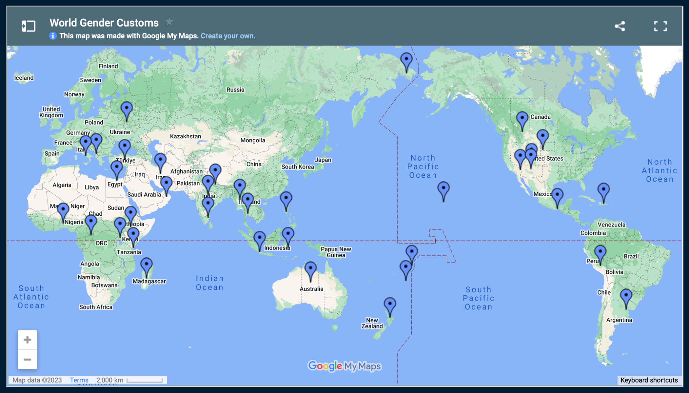
Map of Gender-Diverse Cultures
https://www.pbs.org/independentlens/content/two-spirits_map-html/

Slide 30
Key Takeaways
 | Exploring factors of diversity within and around gender will help participants move towards an understanding of intersectionality and of gender as non-binary
 | The diversity of gender expression and sexual identity is global, and work towards gender equality should reflect the rights and experiences of these groups.

Slide 31
Session 5:
Intersectionality

Slide 32
Learning Objectives
To understand how power and social privilege can be used to marginalize particular groups, specifically those comprised of intersecting identities.

Slide 33
Key Messages
 | This session will unpack the concept of intersectionality and how people will experience different barriers depending on many elements of their identities—things like their sexuality, race, gender identity, ability, and age. Pursuing true equality means recognizing and meeting all peoples’ diverse needs

Slide 34
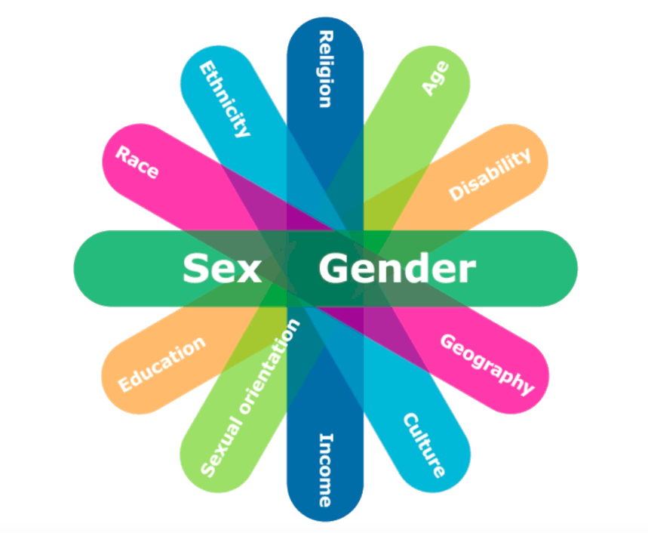
Intersectionality
A theoretical framework for understanding how aspects of a person’s identity (race, class, gender, sex, ability, religion, etc.) combine to create unique modes of discrimination or privilege. The term was coined by black feminist scholar Kimberlé Williams Crenshaw in 1989.

Slide 35
Key Takeaways
Unequal power relations are at the root of gender inequality and exclusion/discrimination.
Recognizing that an individual’s particular experience of intersecting discriminations is unique.
This is particularly relevant when we think about gender and those who have gender expressions outside the binary and as they intersect with other identities/statuses.

