Slide 1
Elements of Gender Transformative Programming
MODULE 2

Slide 2
Session 6:
Gender in the Project Cycle

Slide 3
Learning Objectives
To understand the basic points of the project cycle that will be used for the training, and how it applies to their work.

Slide 4
Key Messages
 | Regardless of your organization’s mandate, a project cycle is a universal and practical approach to understanding the processes within which gender equality and feminist approaches can be integrated.
 | The journey through this training will be hands-on and practical, requiring everyone’s active participation.

Slide 5
Project Cycle
These sessions will explore problem analysis from a gender perspective, rights-based and instrumentalist approaches, taking an holistic approach, and designing transformative programming with gender equality outcomes.
Planning and Design
These sessions will introduce participants to the spectrum of gender equality integration into MEAL, from gender sensitive through to feminist MEAL. They will be introduced to the Gender Based Analysis Plus (GBA+), design indicators for GE outcomes, and explore how data can be collected and used for gender transformative programming.
Monitoring, Evaluation and Learning
Implementation
This session will ask participants to examine different aspects that are key to effective implementation (resources, skills, time) from a gender perspective, exploring the needs, challenges and risks associated with gender transformative programming.

Slide 6
Session 7:
Problem Analysis from a Gender Perspective

Slide 7
Learning Objectives
To become comfortable with the application of a gender lens, and the identification of ‘root causes’.
To recognize gender-related power dynamics between key stakeholders that support inequality.

Slide 8
Key Messages
 | In order to design gender transformative programming, we need to have a deep understanding of the gendered nature of the problem, right down to the root causes.
 | Revising our conceptual understanding of gender inequality can help us to explore these root causes.

Slide 9
Gender
Transformative
Programming
Addressing the root causes of gender related problems and
gender equality.

Slide 10
CORE PROBLEM

Slide 11
A Problem Statement should be…
High stakes. Describe the thing that you want to change: a must have, not a ‘nice to have’.
High level – not a factor or driver of the problem.
Specific. Who is the problem about? Where is it occurring? What is the Scope of the problem?
Relevant. It should focus on a problem that lies at least partly within your area of responsibility or impact.

Slide 12
Identifying Root Causes
Gender gaps in relation to a particular sector focus on addressing the symptoms with little attention given to the root causes.
Symptoms
Root Causes
Social barriers
Unequal decision-making
Women’s time poverty
Lack of resource ownership
Policy/legislative barriers

Slide 14
DIG IN!
To explore the gendered aspects of each problem, ask yourselves:
Does the position of women and girls influence this problem?
What strategic or practical needs are absent and contributing to this problem?
How is intersectionality contributing these causes and to the problem?

Slide 15
Key Takeaways
In order to design gender transformative programming, we need to have a deep understanding of the gendered nature of the problem, right down to the root causes.
Revising our conceptual understanding of gender inequality can help us to explore these root causes.

Slide 16
Session 8:
Understanding a Rights-Based Approach to Gender Equality

Slide 17
Learning Objectives
To have a strong understanding of what is meant by a ‘rights-based approach’ and an ‘instrumentalist approach’.

Slide 18
Key Messages
 | Gender transformative programming should always reflect a rights-based approach; but we must also understand the instrumentalist rationale for gender equality programming.
 | A human rights based approach to programming demands that human rights are the core rationale for any intervention, but it also demands that human rights principles guide all stages of implementation.

Slide 19
Rights are legal, social, or ethical principles of freedom or entitlement; that is, rights are the fundamental normative rules about what is allowed of people or owed to people according to some legal system, social convention, or ethical theory.
(Stanford Encyclopedia of Philosophy)
Human Rights
Negative rights:
Article 4: No one shall be held in slavery or servitude; slavery and the slave trade shall be prohibited in all their forms.
Article 13 (1,3): Everyone has the right to freedom of movement and residence within the borders of each State. Everyone has the right to leave any country, including his own, and to return to his country.
Positive rights:
Article 8: Everyone has the right to an effective remedy by the competent national tribunals for acts violating the fundamental rights granted him by the constitution or by law.
Article 21(1): Everyone has the right to take part in the government of his country, directly or through freely chosen representatives.

Slide 20
A Human Rights-Based Approach
“A human rights-based approach is a conceptual framework for the process of human development that is normatively based on international human rights standards and operationally directed to promoting and protecting human rights. It seeks to analyse inequalities which lie at the heart of development problems and redress discriminatory practices and unjust distributions of power that impede development progress.” – FAQ on HRBA, OHCHR, pg 16

Slide 21
An instrumentalist approach can be understood by asking: “if this problem is solved, what additional external benefits will be seen by others (ie, community, economy, etc)”? An instrumentalist approach to gender equality sees it as a means to the achievement of other goals, such as economic development or sustainable peace and security. An instrumentalist approach to gender equality has often been used to gain support from a wider constituency.
Examples:
“When you educate a girl, national GDP increases by XX %”
Instrumentalist Approach
When a girl’s right to education is fulfilled, the benefits can go beyond her as an individual and will contribute to the economic health of the whole community and country.
“Maternal and infant mortality rates decrease when women have agency to make health-related decisions.”
Every woman has the right to make decisions related to her health. This builds agency and empowerment, and is also shown to reduce maternal and infant mortality rates.
“When women can own and run businesses, the whole economy grows”
“Sustainable peace is more achievable when women are active participants in discussions”

Slide 22
Human Rights Principles
Equality and non-discrimination: All individuals are equal as human beings and entitled to human rights, without discrimination of any kind.
Participation and inclusion: All individuals are entitled to active, free, and meaningful participation in, contribution to, and enjoyment of civil, political, economic, social, and cultural development. The voices and interests of affected individuals are taken into account on issues that concern them and the development of their society.
Transparency and accountability: Individuals have access to information on policies, decisions and use of funds, and are empowered to hold those who have a duty to act accountable. State and non-State actors comply with their applicable obligations and responsibilities.
(GAC)

Slide 23
Key Takeaways
Gender transformative programming should always reflect a rights-based approach; but we must also understand the instrumentalist rationale for gender equality programming.
A human rights based approach to programming demands that human rights are the core rationale for any intervention, but it also demands that human rights principles guide all stages of implementation.

Slide 24
Session 9:
A Holistic Approach:
Understanding the environmental factors of inequality

Slide 25
Learning Objectives
To recognize gender-related power dynamics between key stakeholders that support inequality.

Slide 26
Key Messages
 | Gender inequality is about relational power - or 'position' (discussed in early sessions on terminology/concepts). This makes it necessary to understand power dynamics - both in terms of stakeholders who serve as barriers to empowerment, and those who are allies for empowerment.

Slide 27
Socio-Ecological Model
Individual. This refers to the primary subject or focus of your project or study. Sometimes, in the language of human rights, this would be referred as the ‘rights holder’.
Relationship. This level includes those people with whom the individual has a direct relationship – it is sometimes called ‘interpersonal’. It can include spouses or partners, children and other family members, friends and colleagues. Most often, factors at this level describe family or household dynamics.
Society (Policy)
Community
Relationship
Individual
Community. This level extends into the surrounding community and includes social norms and institutions that define and shape community interactions. This can include religious institutions and cultural norms, commercial activity and educational activities.
Societal (Policy). This level refers to the governance and systems established to provide services, write and enforce laws, protect and defend rights, etc. In the language of human rights, this level would refer to the state as the ‘legal duty-bearer’.
Notes:
Screen-share Mural after this slide discussion.

Slide 28
GROUP DISCUSSION
How is gender inequality sustained?
Who is involved?
What is involved?

Slide 29
DID YOU KNOW?
Engaging men and boys
Engagement of men and boys is essential for gender transformative programming. Men and boys can be seen as both beneficiaries of gender transformative change, and as instrumental partners in gender transformative change for women and girls. Men and boys suffer from deep-seated gender norms related to toxic masculinity, including violence, risky behaviour, poor health and lack of emotional connectedness.

Slide 30
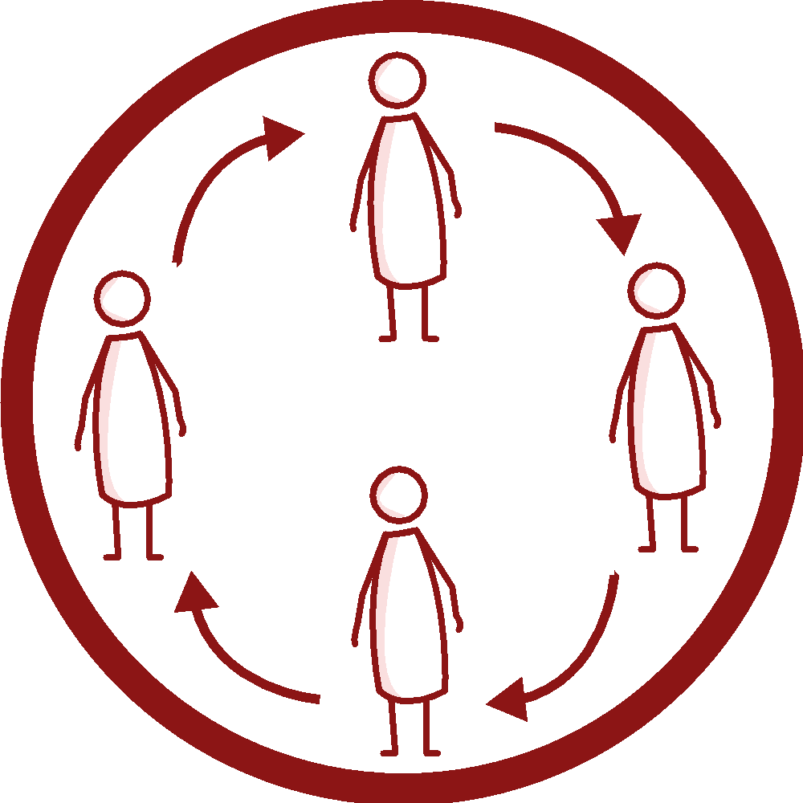
Factors that drive people’s behaviors and actions
Individual (including their knowledge, attitudes, and skills)
Social (social, gender norms, and power dynamics)
Institutional (laws, systems and policies)

Slide 31
PROBLEM TREE ANALYSIS
What specific factors within the household and within interpersonal relationships are affecting different ‘root systems’ in our Problem Tree?
How do community institutions and social norms at the community level either support equality or create barriers to the fulfillment of rights?
How do government institutions and policy influence our problem? What systems-level factors influence this Problem?

Slide 32
DIG IN!
Strengthening the Problem Tree Analysis
Have the ‘root causes’ of the Problem been unearthed?
Does it reflect a rights-based approach to gender equality?
Are factors at all levels being adequately considered in the analysis?
Has the role of men and boys been articulated explicitly?

Slide 33
Session 10:
Towards Design for Gender Equality:
Gender Aware and Gender Transformative Theories
of Change and Logic Models

Slide 34
Learning Objectives
To gain practical experience building a Logic Model with gender equality outcomes.

Slide 35
Key Messages
 | A logic model or Theory of Change is a response to a good Problem Analysis.
 | Every logic model should be at least gender aware, and many can be gender transformative.

Slide 36
Results Based Management
A widely recognized approach to program/project management that emerged as a response to what was seen as an over-emphasis in development programming on activities rather than end results.

Slide 37
The framework for RBM follows three principles, each with an associated tool:
Knowing where you want to be, and plotting your path (Logic Model and Theory of Change)
Results Based Management
Knowing where you are along the journey (Performance Measurement Framework)
Monitoring and adjusting what you do to ensure you reach your destination (Evidence Based Planning and Management).

Slide 38
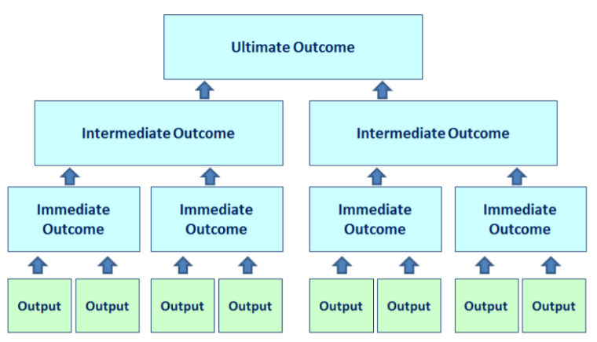
LOGIC MODEL
A logic model is a visual depiction of the theory of change for a specific project, reflecting the series of changes that are critical to achieving project outcomes. It depicts the logical connections between the planned outputs and the expected outcomes that the project aims to achieve or contribute to. The Logic Model’s pyramid structure enables us to illustrate the complex nature of a program or project. Different intermediate outcomes represent different “pathways” leading to the same ultimate outcome.

Slide 39
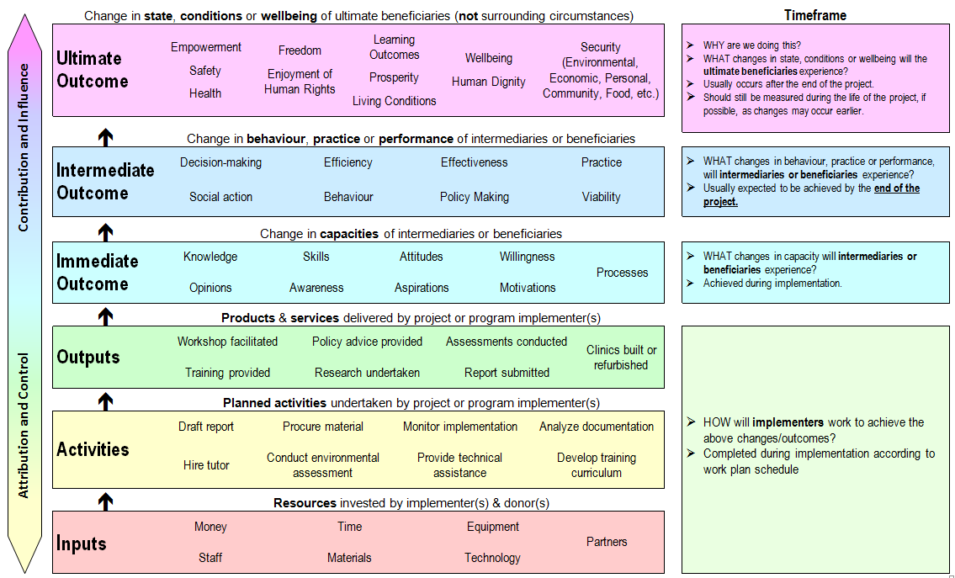

Slide 40
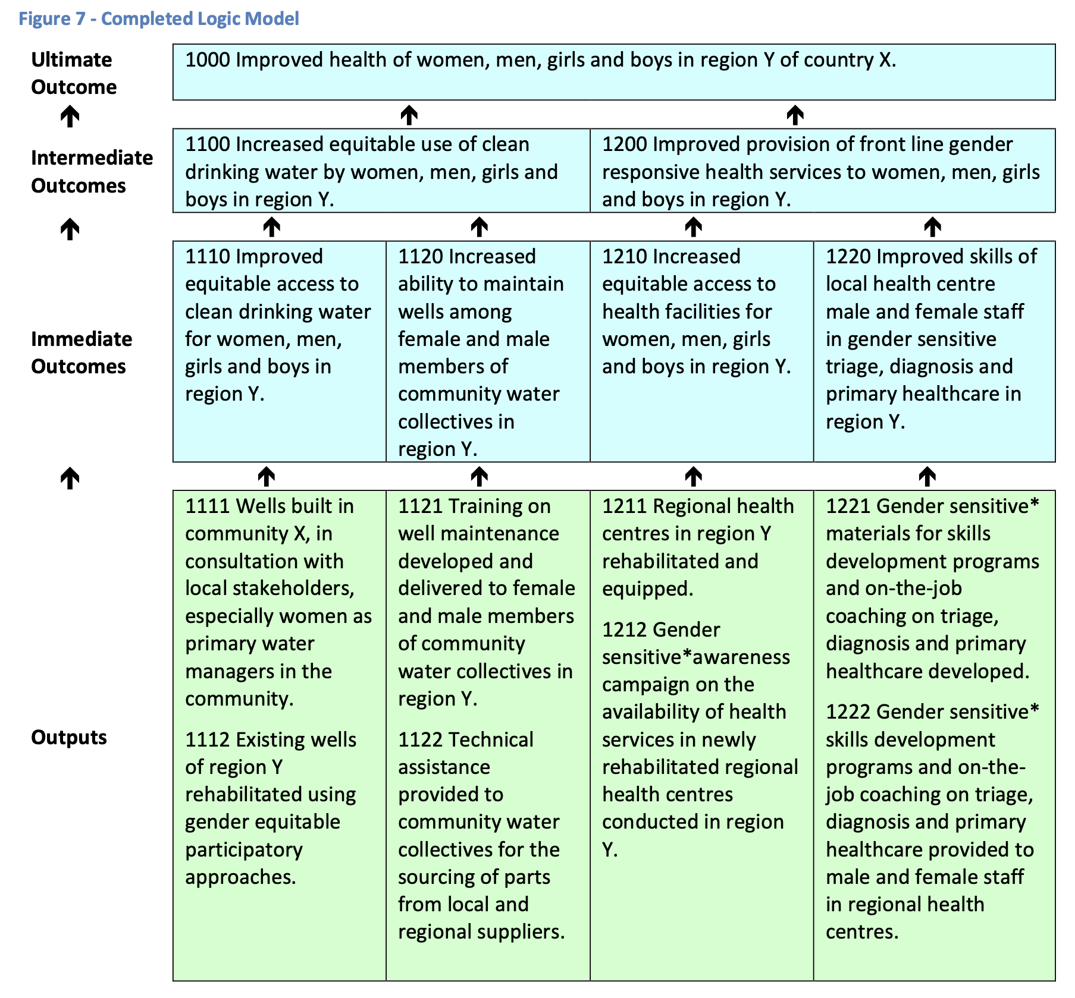

Slide 41
WHAT ELEMENTS
DOES A GENDER EQUALITY OUTCOME STATEMENT HAVE?
 | GE outcome statements explicitly describe an improvement or positive change related to gender equality.
 | GE outcomes statements do not merely refer to ‘women and men’ or add ‘including girls’ to the stated result.
Improved access, especially for adolescent girls, to nutritionally diverse food sources.
Increased decision-making power at the household level for adolescents, especially girls,
related to food purchasing and consumption.

Slide 42
WHY IS THIS IMPORTANT THROUGHOUT THE LM?
Because it formalizes the intention of the project to affect positive change towards gender equality.
Because elements that are included in outcome statements determine the monitoring and evaluation design of a project, the budget of the project, and the management design of a project.

Slide 43
Session 11:
Implementation – Planning for Transformative Change

Slide 44
Learning Objectives
To understand the implications (needs, challenges and risks) of gender transformative programming for key areas of implementation.

Slide 45
Key Messages
 | Achieving change in attitudes, social norms, and behaviours, takes time, skills and investment.
 | The risks of poorly implementing gender transformative programming cause unintentional harm to women and girls.
 | Supporting the implementation of gender transformative programming requires a collaborative effort between budget managers, program managers, and technical staff.

Slide 46
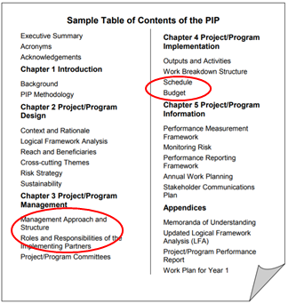
Implementing Gender Transformative Programs - The PIP
The Project Implementation Plan (‘PIP’) is the document created by an organization after a project has been approved. It asks the team to revisit and validate the original project design, to update and adjust as needed, and to create a detailed plan as how, when and with what resources each outcome will be achieved.

Slide 47
Considerations for Elements of Implementation Planning:
Needs, Risks and Challenges
Budget: What are some of the budgetary requirements and challenges in making sure this project is gender transformative?
Work Plan/Timeline: What kind of change is expected? How does that happen and how long does it take?
Human Resources: What are the skills needed? How can the project ensure sufficient skills to make sure the transformative objectives are achieved?

Slide 48
Principles of a Rights-based Approach
Equality and non-discrimination: All individuals are equal as human beings and entitled to human rights, without discrimination of any kind.
Participation and inclusion: All individuals are entitled to active, free, and meaningful participation in, contribution to, and enjoyment of civil, political, economic, social, and cultural development. The voices and interests of affected individuals are taken into account on issues that concern them and the development of their society.
Transparency and accountability: Individuals have access to information on policies, decisions and use of funds, and are empowered to hold those who have a duty to act accountable. State and non-State actors comply with their applicable obligations and responsibilities.
(GAC)

Slide 49
GROUP DISCUSSION
What are some of the similar needs/risks across the different projects?
What individual experiences can participants share from their own work that provide useful examples of some of the implementation requirements and challenges for gender transformative programming?
Based on the complex interconnection between these implementation elements for GT programming, whose responsibility is gender equality throughout project implementation?

Slide 50
Gender Equality Markers
Gender Equality Code | Explanation of GE coding:
GE-3 | Targeted - Gender equality is the principal objective of the initiative: The initiative was designed specifically to address gender inequalities and would not otherwise be undertaken. All outcomes in the logic model are gender equality outcomes.
GE-2 | Fully integrated -There is at least one intermediate gender equality outcome which will achieve observable changes in behaviour, practice, or performance that will contribute to gender equality.
GE-1 | Partially integrated - There is at least one gender equality outcome at the immediate outcome level which will achieve a change in skills, awareness, or knowledge that contributes to gender equality.
GE-0 | None - There are no gender equality outcomes.

Slide 51
Key Takeaways
Achieving change in attitudes, social norms, and behaviours, takes time, skills and investment.
The risks of poorly implementing gender transformative programming is the potential to cause unintentional harm to women and girls, and reinforce gender discriminatory norms.
Supporting the implementation of gender transformative programming requires a collaborative effort between budget managers, program managers, and technical staff.

