Slide 1
Gender Transformative and Feminist MEAL
MODULE 3

Slide 2
Session 12:
Gender-Based Analysis

Slide 3
Learning Objectives
Participants will have a stronger understanding of the foundational components of gender analysis and confidence to approach the planning and design of a gender analysis.

Slide 4
Key Messages
 | Gender analysis provides essential information to inform gender transformative programming and implementation.
 | Gender analysis can build on existing frameworks and should be tailored to the needs of your initiative.
 | Gender analysis should happen throughout the project cycle and can be conducted by any organization.

Slide 5
Understanding Gender Analysis
WHAT?
What do we analyze in a gender analysis?
HOW?
How do we conduct a gender analysis?
WHEN?
When do we conduct gender analysis?
WHO?
Who should conduct a gender analysis?

Slide 6
WHAT?
What do we analyze in a gender analysis?
What data do you collect?
What do we analyze?
Who does what? Roles, responsibilities, expectations… why?
Who has what? Resources, opportunities, power…. why?
Who decides what? In the household...community… government… why?
Who gains? Who loses?
Who has conducted a gender analysis?

Slide 7
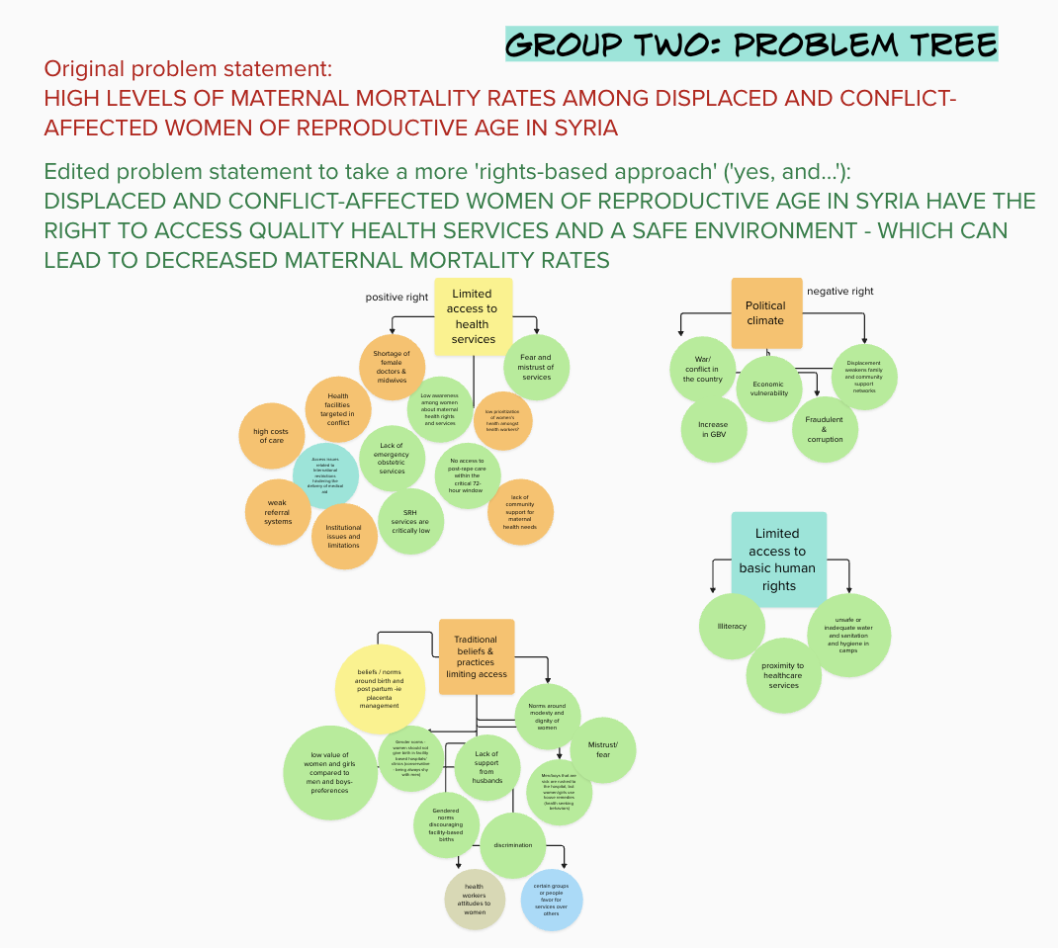
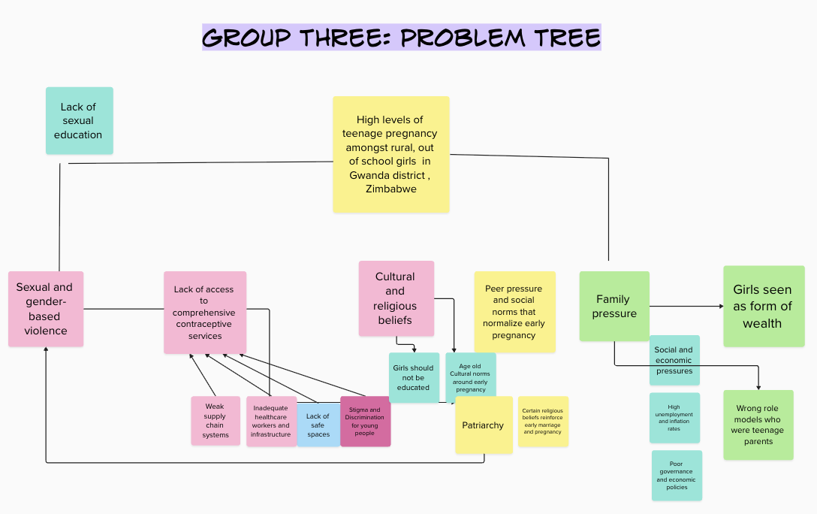
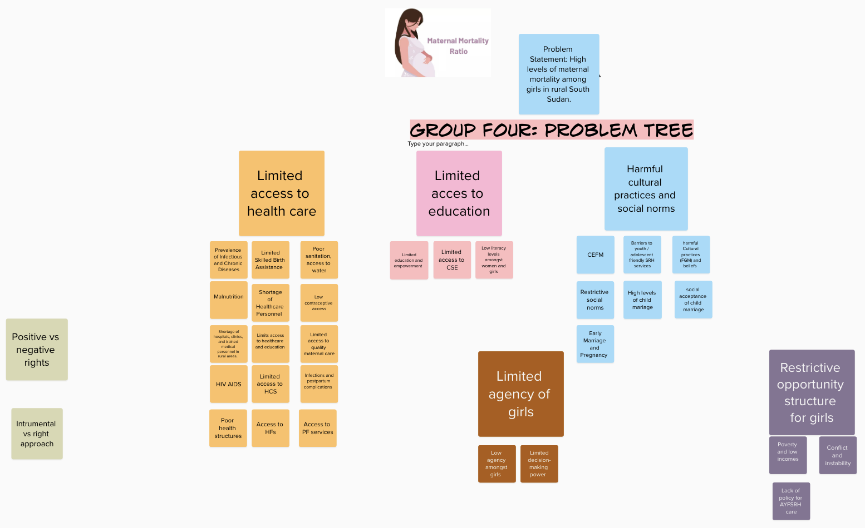

Slide 8
Gender Analysis Frameworks
Gender Analysis Frameworks provide step-by-step methodologies for conducting gender analysis. A thorough gender analysis should reflect the ways in which all other cross-cutting issues (age, environment, ethnicity, rights) also impact on women, men and gender diverse people.
Common domains you will often see used by various organizations and institutions pull from all these frameworks, and might include:
Roles & Responsibilities
Social norms/gender norms
Participation and decision making
Access to/control over resources
Systemic/
institutional norms

Slide 9
Global Affairs Canada’s GBA+
Global Affairs Canada defines Gender-based analysis (GBA+) as an analytical process used to assess how diverse groups of women, men and non-binary people may experience policies, programs and initiatives.⁶ The “plus” in GBA+ acknowledges that GBA+ goes beyond biological (sex) and socio-cultural (gender) differences. GBA+ considers many identity factors, such as race, ethnicity, religion, age, and mental or physical disability.

Slide 10
HOW?
How do we conduct a gender analysis?
Defining your framework
Desktop and secondary research
Design of primary data collection tools
Data collection
Analysis

Slide 11
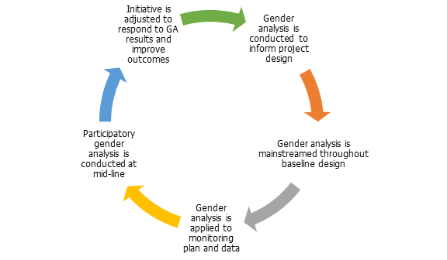
WHO?
Who should conduct a gender analysis?
It is very important that gender analysis is not thought of as a task exclusively delivered by gender equality experts. Gender analysis is an ongoing process and should be integrated into many stages throughout the project cycle, and is the responsibility of all staff.
WHEN?
When do we conduct gender analysis?

Slide 12
Key Takeaways
 | Gender analysis provides essential information to inform gender transformative programming and implementation.
 | Gender analysis can build on existing frameworks and should be tailored to the needs of your initiative.
 | Gender analysis should happen throughout the project cycle and can be conducted by any organization.

Slide 13
Session 13:
MEAL:
From Gender Sensitive to Gender Transformative and Feminist

Slide 14
Learning Objectives
To understand that integrating and reflecting gender transformative and feminist approaches to MEAL exist on a spectrum, and can be applied to both process and outcome of MEAL activities.

Slide 15
Key Messages
 | Gender integration in MEAL activities must be comprehensive by addressing gender considerations in both process and purpose.
 | The spectrum builds on itself as it intensifies. For example, gender transformative monitoring activities will necessarily have the characteristics of gender sensitive and responsive monitoring activities.
 | Gender sensitive is the absolute bare minimum of gender integration that can be considered as good practice.

Slide 16
MONITORING is normally the systematic assessment of a programme’s performance over time. It involves the ongoing collection and review of data to provide programme managers and other stakeholders with indications of progress against programme plans and towards programme objectives.[1]
EVALUATION takes place at a particular point in time, but complements ongoing monitoring activities by providing more in depth, objective assessments of the relevance, efficiency, effectiveness, impact and sustainability of programmes. Formative evaluations are carried out during the life of the programme with a focus on improvement; summative evaluations take place towards the end of the programme and are used to judge its overall merit, worth or effectiveness.
ACCOUNTABILITY mechanisms include crucial information sharing to project or organization stakeholders about the delivery of services, the use of resources, and the achievement of outcomes. This includes project donors, partners and beneficiary or participants communities. Accountability to government or donors is sometimes referred to as ‘upward accountability’, accountability mechanisms targeting beneficiary groups or communities is referred to ‘downward accountability’, and ‘horizontal accountability’ refers to sharing and learning activities with partners, colleagues, peer organizations and stakeholders.[2]
LEARNING activities are deliberate efforts to use project data (qualitative/quantitative/formal/informal/observational) to reflect on and improve upon programmatic and operational approaches. This often involves specific research initiatives.
MEAL

Slide 17
GE Integration
 | Gender Aware/Sensitive | Gender Responsive | Gender Transformative / Feminist
Monitoring | Monitors female and male beneficiaries and stakeholders Takes gender into consideration during planning and risk analysis for data collection Captures and organizes data disaggregated by sex/age | Monitors female and male beneficiaries and stakeholders Takes gender into consideration during planning and risk analysis for data collection Captures and organizes data disaggregated by sex/age Monitors gender-based differences between participation in and benefit from intervention Ensures meaningful participation of women and girls in monitoring activities | Monitors female and male beneficiaries and stakeholders Takes gender into consideration during planning and risk analysis for data collection Captures and organizes data disaggregated by sex/age Monitors gender-based differences between participation in and benefit from intervention Ensures meaningful participation of women and girls in monitoring activities Co-designs monitoring activities with women and girl participants Ensures the use of monitoring tools that capture individual and experiential data Uses monitoring activities that are empowering in and of themselves
What do you see as you move across the spectrum?
What are some of the practical implications to consider?

Slide 18
Upward Accountability: donors, sponsors, clients, government, taxpayers
Data for what purpose?
Data for whom?
Horizontal Accountability: community of practice, peer organizations/institutions, stakeholders, members of gender equality and feminist movements, cluster members
Downward Accountability: beneficiaries/participants; community members

Slide 19
Key Takeaways
Gender integration in MEAL activities must be comprehensive by addressing gender considerations in both process and purpose.
The spectrum builds on itself as it intensifies. For example, gender transformative monitoring activities will necessarily have the characteristics of gender sensitive and responsive monitoring activities.
Gender sensitive is the absolute bare minimum of gender integration that can be considered as good practice.

Slide 20
Session 14:
Quality Indicators for Gender Equality Outcomes

Slide 21
Learning Objectives
To understand how to construct and select quality indicators to support gender equality outcomes and gender transformative programming

Slide 22
Key Messages
 | Indicators are a signal of change, and need to effectively respond to the level of change in project outcomes; they MUST be gender sensitive as a minimum level of gender equality integration
 | Gender transformative change refer to changes in social behaviours and attitudes (position, not just condition), and therefore requires a combination of indicators that must include qualitative indicators

Slide 23
Performance Measurement Framework
Expected Result | Indicator(s) | Baseline Data | Targets | Data Sources | Data collection Methods | Frequency | Responsible
Outcome or Results Statements | What is being measured? | Where you are starting from? | Where will you end up? | Where or who is the data coming from? | How is it being collected? | How often is this data being collected? | Who is collecting the data?

Slide 24
What is an indicator?
An indicator is a signal that shows change has happened.
Every indicator has 3 building blocks:
There are 2 types of indicators:
Quantitative Indicator:
Used to measure quantities or amounts
They are objectively verifiable.
For example: temperature, distance, middle upper-arm circumference, death rate, but also individual knowledge and skills.
Qualitative Indicator:
They are subjective
They capture experiential information, such as the quality of something, or beneficiaries perception of their situation, their opinion or preferences
They also would measure an individual’s perception of their own knowledge or skills
The unit of measure is the number, percentage, level, ratio, etc.
The unit of analysis is who or what will be observed: individuals, institutions, social artifacts or social groups.
The context is the set of circumstances that specify the particular aspect of the output or outcome that the indicator is intended to measure.

Slide 25
What is an indicator?
An indicator must always be developed or selected to effectively capture the level of change of a result (tranformative/aware/etc.), and must ALWAYS be gender sensitive, regardless of the level of change. Gender sensitive is the minimum level of gender integration.
What do we mean by this?
When we talk about gender transformative results, in order to be effective, we want to measure changes in attitudes and perceptions about the value of women and girls and their agency and decision making. Most outcomes have multiple indicators and will include some that are quantitative and some that are qualitative.
Gender sensitive indicators do the following:
Disaggregate by sex and age
Disaggregate by other relevant factors of intersectionality
Use language that describes in gendered detail the unit of analysis
Use language that includes gender-related elements of the context

Slide 26
Identify the specific aspects of the indicators in the table that make them gender sensitive:
Unit of Measure | Unit of Analysis | Context
#/total | Adolescent girls and boys aged 15-19 (disaggregated by rural/urban setting) | Who have attended a health clinic in the past 12 months.
Level of confidence | of male partners of women of child-bearing age | in the privacy provided during family planning counselling
%/total | health institutions (public/private) | providing gender sensitive services to ethnic populations in their language of choice
Degree of support | Amongst adult males | For women’s engagement in work outside the home
%/total | of individual citizens trained (disaggregated by sex, age, and provinces) | reporting change in media consumption habits one month after participating in the propaganda-proof training
# | of policy proposals passed | that create conditions for national reconciliation in conflict zones
Ratio | of women to men | in decision-making positions in the government

Slide 27
In order to respond to this outcome, would we want to measure only the rate of usage of contraceptives by adolescent girls?
“Increased empowerment of adolescent girls to claim their right to safe and accessible contraceptive services and resources.”
NO
... in fact, we also must measure whether that right is being realized – which requires us to measure their agency in the decision to use contraceptives. Usage rates alone do not tell us about an adolescent girl’s empowerment.

Slide 28
Data Sources & Collection Methodologies
Which methodologies would be more effective for gathering data related to gender transformative change?
Which methodologies would be more aligned with feminist principles? Why?
Data Collection Methods
Conversation with concerned individuals
Most significant change
Field visits/observation
Transect walk
Critical reviews of official records or other documents
Individual and key informant interviews
Focus group discussions
Guided observation
Official records/secondary data
Surveys
Census
Scientific research
Data Sources
Primary:
Participants (individuals)
Intermediaries
Secondary:
Demographic health survey data
Human development report
Global Peace Index
Peer reviewed research
Reports from community of practice

Slide 29
How can we measure complex concepts like AGENCY, CHOICE and EMPOWERMENT?
Asking participants directly about their empowerment, agency, choice.
Using an indicator that suggests empowerment/agency, sometimes known as ‘proxy’ indicator.
Using a composite indicator or index to measure the multi-dimensional aspects of empowerment and agency.

Slide 30
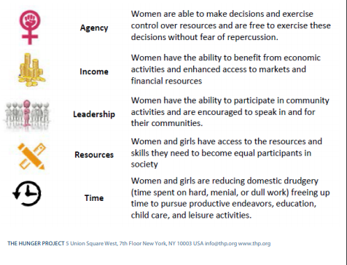
Hunger Project’s Women’s Empowerment Index

Slide 31
Key Takeaways
Indicators are a signal of change, and need to effectively respond to the level of change in project outcomes; they cannot be gender transformative but MUST be gender sensitive as a minimum level of gender equality integration
Gender transformative change refer to changes in social behaviours and attitudes (position, not just condition), and therefore requires a combination of indicators that must include qualitative indicators

