Slide 1
Inclusion of Women and Girls with Disabilities into Health and Gender Equality Programming
Webinar 1

Slide 2
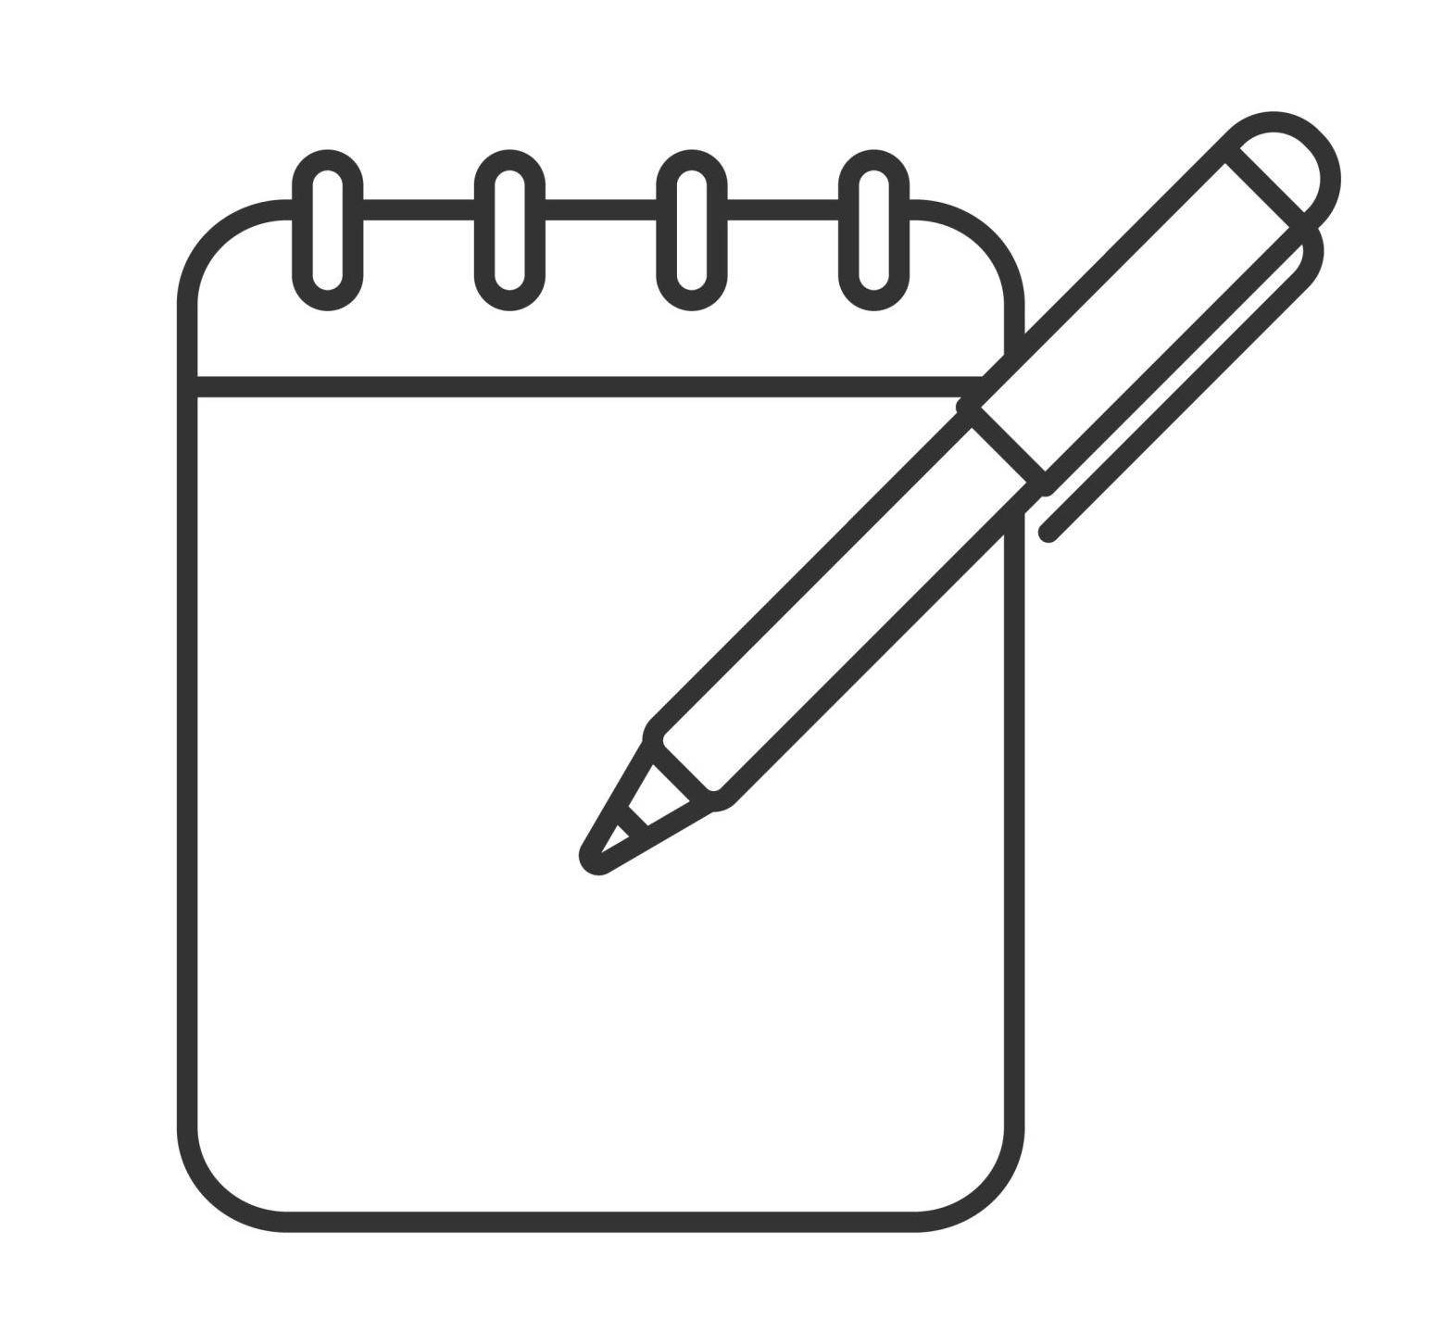
Question to consider
When you hear or see the terms ‘disability’ and ‘people with disabilities’ what images, words and phrases come to your mind?
Make a list of all the words, phrases and images that you think of.

Slide 3
The power of assumptions
We all make assumptions about people we do not know (and some about those we do) based on many factors acquired over our lifetimes - from a combination of sources/experiences/values/cultures. They are our way of coping with life in a complex social environment.
Assumptions can be very useful. But some assumptions can also create a barrier, when they falsely prevent others from succeeding. Our assumptions are generally a mixture of accuracy and stereotypes

Slide 4
The power of assumptions
People with disabilities commonly report their daily ‘lived’ experience is that many assumptions are made about them before they are ever spoken to or engaged with. Most are generally based on prejudice and discrimination.
We all carry personal assumptions about people with disabilities. These are based on our experiences, values and cultural “lenses” acquired throughout our lives. Being self-aware of these assumptions are an important starting point of the journey into international development work to considering greater inclusion of persons with disabilities.

Slide 5
The three
models of disability
explained

Slide 6
THE MODELS OF DISABILITY
To understand how societies conceptualize and react to disability, and how development and many health professionals approach disability, it is important to recognise that there are different ‘models’ of disability.
There are three predominant models of disability in use around the world today. These will be described in turn.
The key point to note at the start is that power relations regarding the role of society, professionals and people with disabilities are at the heart of the difference between each of the models.

Slide 7
Individual Model: Medical Approach
Disability is a problem in the person
focuses on a person’s impairment as the obstacle;
seeks to "cure" or "improve" individuals to "fit" them into society;
leads to segregated services resulting in exclusion from the mainstream with the rationale that this means better, specialised services can be provided;
decision making is in the hands of specialists or professionals with little or no regard to the rights of individuals;
expensive, tends to benefit relatively few;
people with disabilities have a passive role in developing and implementing disability policy and practice.
SOCIETY
Persons with disabilities
Activities "fix" disabled person, who is "sick", so they can join "normal" society.
Source: Coe and Wapling, 2010

Slide 8
Individual Model: Charity Approach
Disability is a problem in the person
regarded as "unfortunate", "dependent" or" helpless";
seen as people who need pity and charity, often with roots in traditional understandings that impairments result from sin, ill-favour or curse;
assumes people with impairments cannot contribute to society or support themselves;
provides them with largely money or gifts, such as food or clothing;
Persons with disabilities become long-term recipients of welfare and support;
aid provided by specialist organisations not mainstream development.
SOCIETY
Persons with disabilities
Activities "help" disabled people who are "helpless" and outside "normal" society.
Source: Coe and Wapling, 2010

Slide 9
Social/Human Rights and Empowerment Model
Disability results from barriers in society
sees disability as the social consequences of impairment;
regards persons with disabilities as part of society, rather than as separate;
people are disabled by society denying their rights and opportunities;
persons with disabilities’ needs and rights are the same as non-disabled people’s, e.g. for love, education, employment;
leads to inclusive approaches to education, health, employment and other services by encouraging the participation of people with disabilities in mainstream programming;
activities focus on identifying and removing access, institutional and attitudinal barriers that block inclusion;
Underpinned by national and international legislation including the UN Convention on the Rights of Persons with Disabilities.
SOCIETY
Persons with disabilities
Activities focus on inclusion, recognising explicitly that disabled people are a normal part of all societies.
Source: Coe and Wapling, 2010

Slide 10
Social/Human Rights and Empowerment Approach
Disability results from barriers in society
SOCIETY
Programme intervention
Persons with disabilities
Younger women
Persons with disabilities
LGBTQI+ community
Activities focus on inclusion, identifying and eliminating access, attitudinal and institutional barriers. Persons with disabilities are explicitly recognised as a normal part of all societies.
Source: Coe and Wapling, 2010

Slide 11
Why are the models important?
Not just about words – but ideas, attitudes and practices.
They are a simplified summary of who has power and legitimacy - and therefore who gets what, when and how. Each is a different perspective of how “disability” is understood.
They illustrate who are the ‘gatekeepers’ of financial and human resources and describe how policies and practices are decided.
The disability model adopted will determine the roles of professionals in SRHR service provision approach (are service providers working for or with persons with disabilities? Are professionals ‘on top’ or ‘on tap’?).
##

Slide 12
Why does the definition of disability matter?
Because it fundamentally links to issues of power, legitimacy and agency.
The underpinning of “disability” will determine who sets the agenda and sets priorities in SRHR work.
Different views of disability in society
Different models
Different policies and practices in the real world
Different experiences for persons with disabilities

Slide 13
Defining Disability
Impairment
Disability
Characterised by:
Problems in body function or structure;
Conditions caused by disease or injury that affect a person's functioning or appearance. e.g. lacking part of or all of a limb; or a limb, organ or system that doesn’t fully function;
Long-term or short-term problems;
Single or multiple problems.
Use impairment when you want to describe what makes an individual different from others (i.e. the physical, sensory, cognitive, or mental health problem(s) they have).
Characterised by:
The results of limitations imposed on people with impairments;
Those limitations prevent their full and active participation in society;
Attitudinal, environmental and institutional barriers prevent inclusion.
Use disability when you want to describe the affect or impact that an impairment has on an individual’s opportunity to carry out daily tasks (i.e. impairment + barriers = disability).

Slide 14
International definition of disability
‘…disability results from the interaction between persons with impairments and attitudinal and environmental barriers that hinders their full and effective participation in society on an equal basis with others,’
Source: UN Convention on the Rights of Persons with Disabilities (CRPD) Preamble (e)
In summary:
Disability = impairment + barriers
(NB: most perceive disability = impairment only)

Slide 15
Returning to the question:
When you hear or see the terms ‘disability’ and ‘people with disabilities’ what images, words and phrases come to your mind?
Reflect on the list you made earlier – for each item, which model would you place it against?

Slide 16
Intersectionality
“The Chances of Life”
- exercise on Mural

Slide 17
The 4 Powers:
Power over: Often associated with negative power: oppression or repression, denying people freedom of movement, of speech, of action; often found in conflict and crises, but also in every-day life, e.g. difficulty securing a job or housing on the basis of names associated with an ethnic minority; being rejected in marriage/adoption/IVF applications for LGBTQI communities. Removal of legal capacity for persons with disabilities, which can lead to institutionalization and the State taking away their children; medical procedures such as invasive and coercive contraception including sterilization | Power to: Ability to decide and carry out actions, to resist oppression or create new things/opportunities; decision making within the household, community, and more broadly; potential of every individual to shape their life. e.g. woman’s power to leave an abusive husband, or to go to work; a young person to decide when to marry and what profession to learn, a person with disabilities to decide to live on their own; a young woman with disabilities making her own sexual and reproductive choices
Power with: Ability to find common ground among different interests and to act collectively, based on solidarity and mutual support; building collective strength; building and making use of networks e.g. organisations of persons with disabilities (OPDs), women’s associations, young persons’ clubs and organisations, older people’s associations (OPAs) | Power within: Knowledge, individual capabilities, sense of dignity, self-esteem and self-belief to imagine and make changes in their lives; personal dignity often linked with culture and/or religion which influence thoughts and actions but also as members of a movement such as disability, women’s, LGBTQI+, or indigenous movements

Slide 18
How then, does the power analysis
relate to the models of disability?

Slide 19
The individual models of disability represent a position of power, where non-disabled society assumes superiority (power over).
as providers of support, for example, money, clothes, food;
or professional opinions, for example working as health professionals, making referrals to the medical sector, or by creating special education or livelihoods programmes based on assumed impairment needs.
In these situations, persons with disabilities rarely get the power to decide and act for themselves.
Institutional barriers can result in power over/with/to
Access (environmental) barriers can result in lack of power to/with
Attitudinal barriers can negatively influence the power within with the effect of limited power to

Slide 20
The Context:
An organisation designed Life Skills training programmes for adolescents and young persons, particularly to help them prepare for transitioning to work. The organisation was keen to include adolescents with disabilities.
Exercise:
What happened | Barriers | Power
In adapting the training, a lot of effort went into issues of accessibility. | ?
During many group-work exercises, the adolescents with disabilities rarely participated. |  | ?
They lacked the confidence to share their opinions and/or their experience. |  | ?
Their peers without disabilities didn’t have the maturity and/or sensitivity to be curious and take the time to engage them. | ?
Adolescents without disabilities were dominant when it came to reaching consensus and making decision. |  | ?

Slide 21
The solution
Both adolescents with and without disabilities could have benefited from separate preparatory sessions to support them before participating in a joint training programme:
  For the adolescents with disabilities, the preparation would have focused on strengthening the power within to encourage power to.
  For adolescents without disabilities, the focus could have been on access and attitudinal barriers to ensure awareness about extra time for participation, as well as understanding different life experiences.
Being aware of the potential power differences ahead of delivering this training would have improved participation.

Slide 22
Exercise before Webinar 2:
Please read the UN Convention on the Rights of Persons with Disabilities (CRPD). It is a user-friendly document! Available in many different languages and formats
https://social.desa.un.org/issues/disability/crpd/convention-on-the-rights-of-persons-with-disabilities-crpd

