Slide 1
Inclusion of Women and Girls with Disabilities into Health and Gender Equality Programming
Webinar 2

Slide 2
Key international framework:
UN Convention on the Rights of Persons with Disabilities (CRPD)

Slide 3
UN Convention of the Rights of Persons with Disabilities (CRPD)
‘..the Convention is intended as a human rights instrument with an explicit, social development dimension; it is both a human rights treaty and a development tool.’
(UNESCO, 2008)
adopted in 2006 and came into force in 2008.
50 articles.
unprecedented levels of involvement from the civil society sector, especially people with disabilities.
most detailed of all the UN human rights treaties.
main purpose is to:
‘..promote, protect and ensure the full and equal enjoyment of all human rights…by persons with disabilities...’ (Article 1)

Slide 4
The CRPD and International Development
The CRPD outlines key principles and definitions in approach, plus 50 articles detailing obligations for State Parties who ratify the CRPD to implement.
Article 1
“Persons with disabilities include those who have long-term physical, mental, intellectual or sensory impairments which in interaction with various barriers may hinder their full and effective participation in society on an equal basis with others.”

Slide 5
The CRPD and International Development
A unique feature of the CRPD is the inclusion of an article on international cooperation. Member States now have an obligation to ensure that all development aid is:
‘….inclusive of and accessible to, persons with disabilities’ (Article 32)
For the first time, there is now a binding commitment to ensure equality and inclusion not only domestically but also through development aid.

Slide 6
The CRPD – women with disabilities
Article 6 - women with disabilities: includes:
“States..recognize that women and girls with disabilities are subject to multiple discrimination and..shall take measures to ensure..full and equal…human rights and fundamental freedoms”

Slide 7
The CRPD - health and reproductive health
Article 23 - respect for the home and family: includes
“the rights of persons with disabilities..to have access to age-appropriate information, reproductive and family planning education…and the means..to enable..exercise of these rights.”

Slide 8
The CRPD - health and reproductive health
Article 25 – health: includes
“Persons with disabilities have the right to…the highest attainable standard of health without discrimination. State Parties shall take all appropriate measures..to ensure access to health services that are gender sensitive, including health-related rehabilitation.”
“State Parties shall provide..the same range, quality and standard of free or affordable health care as provided to other persons, including sexual and reproductive health and population-based public health programmes.”

Slide 9
The CRPD: why it matters
Steady increase in the number of governments passing or amending pro-disability legislation
Current CRPD ratification status (April 2025) = 192 countries
Full information available on the UN CRPD website: https://social.desa.un.org/issues/disability/crpd/convention-on-the-rights-of-persons-with-disabilities-crpd

Slide 10
Core Disability Inclusion Elements
Accessibility, Budgeting, Data,
Partnership, Participation

Slide 11
Disability Inclusive
Budgeting
Accessibility
Data
Participation
Partnership

Slide 12
Accessibility
Access (Environmental)
Buildings, roads, transportation, other indoor and outdoor facilities, including schools, sport facilities, housing, medical facilities and workplaces
Information, communications and other services, including electronic services and emergency services
Attitudinal
Willingness to engage
Understanding specific requirements by persons with different impairments
Adapting services and behaviour to remove barriers

Slide 13
Reasonable Accommodation
Usually works on a case-by-case basis, often in response to an individual need
It is usually provided to ensure the individual can participate
Can be temporary, for example, removable ramp, computer screen-reader
These adjustments will be needed in environments that aren't accessible. Therefore: the more accessible the environment, the less reasonable accommodation is necessary

Slide 14
Budget for | Item | Occasion
Reasonable Accommodation & Accessibility Reasonable accommodation is on a case-by-case basis, often in response to an individual need. These adjustments will be needed in environments that aren't accessible, the more accessible the environment, the less reasonable accommodation is necessary | Travel costs for persons with disabilities and their assistants as necessary | Meetings with government and other partners
 |  | Training for persons with disabilities
 |  | Consultation
 |  | Data collection
 | Sign Language Interpreters | Meetings with government
 |  | Consultation
 |  | Data collection
 | Accessible venues | Meetings
 | Accessible technical material | Material including diagrams and other visual readable by screen reading software
 |  | Language simple and inclusive
 | Accessible online events | Captions, sign language interpretation, different language translations
Specific targeted activities | Disability awareness raising events | Awareness of communities and stakeholders
 | Meetings | Partnership development
 | Training | capacity development of OPD/SHG
 | Support to activities, for example: accessibility audits | Audits implemented by OPDs/SHGs
Human Resources |  | Disability expertise for project

Slide 15
Budgeting
Budgeting will need to consider accessibility and reasonable accommodation to:
Ensure participation of persons with disabilities in the project
Enable collection of data,
Enable relevant partnerships and capacity development of a range of stakeholders
Transport costs for persons with disabilities and their assistants as necessary
Sign Language Interpreter
Flexible working hours; quiet space
Screen reader software
Accessibility
Accessible venues
Accessible information and material (e.g. training)
Supportive activities/investments
Disability audit
Disability focal point

Slide 16
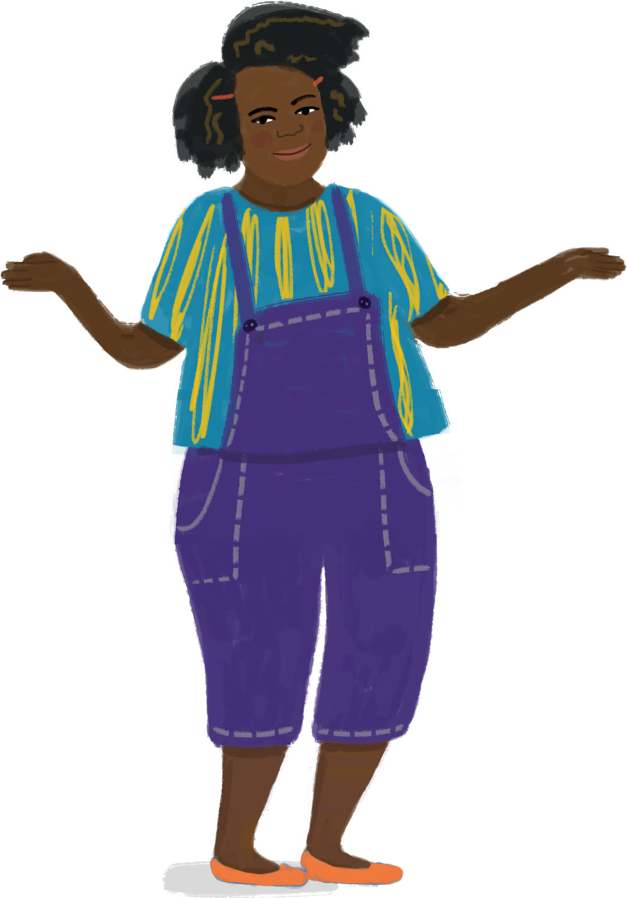
Pause for reflections
  Is there something that I would like to have clarified?

Slide 17
The disability data dilemma
Not a straightforward process – simply asking ‘do you have a disability’ is not effective.
Why?
          Many people do not label themselves as disabled
          Having a disability can be shameful
          Disabilities are not always obvious
          Feelings of disability can be comparative (time/space)
This leads to inconsistent data which often significantly underestimates real world prevalence, which is not comparable and not reliable

Slide 18
Data Disaggregation
Data is essential for
making information about disability visible
to monitor against process and results against indicators
to generate evidence that can influence decision makers to act
The recommended approach to disability identification, quantitative data collection and disaggregation are using the Washington Group Questions
The WGSS can be incorporated into a range of data collection processes and tools and used at all stages of the project management cycle, for example:
Situation and barrier/power analyses
Project/programme baseline and end-line surveys/evaluations
Regular service-level information, monitoring whether services are reaching persons with disabilities and to implement in response to barrier/power analyses

Slide 19
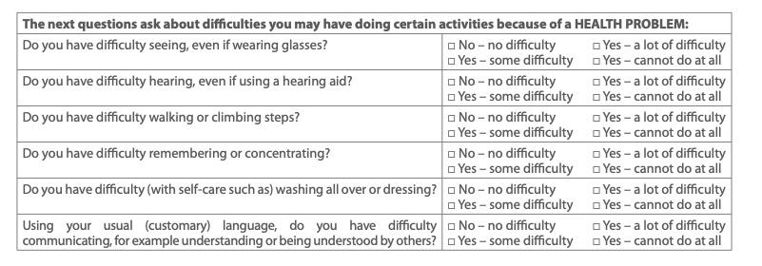

Slide 20
Situation Analysis
Any questions or review about knowledge, attitudes and/or practice relating to education, health/SRHR, GBV or other relevant thematic areas should also include questions and probes about:
Accessibility – are services accessible to persons with disabilities in terms of physical access, accessible information, diverse and/or alternative communication?
Attitudes – are girls and boys and non-binary children and young and older persons with disabilities welcome, are they supported to participate and express themselves, are treated fairly and respectfully relative to their peers without disabilities?
Provision of specific measures – are policies and systems in place to include diverse persons with disabilities as a rule and principle, rather than a case-by-case scenario, if that.
##

Slide 21
Situation Analysis
Original Question:
What are the government policies, strategies, and action plans for women’s rights and gender equality?
Disability-inclusive rephrasing or probing:
What are the government policies, strategies, and action plans for women’s rights, and to what extent are women with disabilities included, e.g. through specific articles, or explicit mention of the specific situation of women with disabilities?
Probe: Do budgets for the implementation of policies, strategies and action plans include reasonable accommodation for the inclusion of women with different disabilities?
Original Question:
Are there safe spaces for women, and to participate in recreational activities, and/or receive counselling etc?
Disability-inclusive rephrasing or probing:
Are there safe and disability-accessible spaces for women, to participate in recreational activities, and/or receive counselling etc. Are these activities inclusive and adapted to so that women with different disabilities can participate? Are counselling sessions accessible to provide appropriate channels of communication for women with hearing or intellectual disabilities?
##

Slide 22

Indicators
Original Indicator:
Proportion of health units with at least one service provider trained to care for and refer VWA/G survivors
Disability-inclusive indicator in addition to original:
Proportion of health units with at least one service provider trained to care for and refer VAW/G with disabilities
Original Indicator:
Proportion of law enforcement units following a nationally established protocol for VAW/G complaints
Disability-inclusive indicator in a multi-country programme:
# of nationally established protocols that explicitly include women and girls with disabilities
Original Indicator:
The proportion of VAW/G cases that were investigated by the police
Disability-inclusive rephrasing:
Proportion of sexual violence cases that were investigated by the police , disaggregated by disability and age
Original Indicator:
Number of shelters and hotlines available for women and children
Disability-inclusive rephrasing:
Number of accessible shelters and hotlines available for women and children with and without disabilities
##

Slide 23
Pause for reflections
  Is there something that I would like to have clarified?

Slide 24
Partnership & Collaboration
Partnership working with:
network organisations/hubs
grassroot organisations directly.
To build truly equal partnerships, programmes should invest in time and training to ensure that people with disabilities have the skills and knowledge to engage in design, analytical input and interpreting data so that the process includes the participants concerns and unique interpretations
Organisations of Persons with Disabilities (OPDs)
Self-Help Groups (SHG)
Disability Non-Governmental Organisations (NGOs)

Slide 25
The International Disability Movement – a brief intro
From the mid-1970’s onwards, for the first time people with disabilities came together to establish organizations to represent their voice and interests. These are known as Organizations of Disabled People (OPDs).
Ideologically, its foundations can be found in the social model of disability.
Based on firm principles that persons with disabilities have the right to be in strategic and leading roles in the development, management and evaluation of all policy and services that affect their lives - disability related or not. ‘Nothing about us, without us’ became – and is - the rallying cry.

Slide 26
Partnership & Collaboration
Organisations of Persons with Disabilities (OPDs)
(Also known as Disabled Persons’ Organizations [DPOs])
Organizations of people with disabilities.
OPDs are run and managed by persons with disabilities and are primarily concerned with promoting disability rights and access to services.
Key characteristics
Membership organizations
Led and managed by persons with disabilities / caregivers
Majority of members are people with disabilities
Represent the voice and interests of people with disabilities.
OPDs can be impairment specific, or cross-disability and can exists at different levels from grassroots to global.

Slide 27
Partnership & Collaboration
OPDs engage in a wide range of activities but some key ones include:
Psycho-social support - to members and their families;
Impairment based support – ranging from sign language to mobility training;
Awareness raising and sensitisation – with families, communities, leaders etc.;
Mobilization – with disabled people to enable them to understand their rights;
Organizational development – training in basic leadership, planning etc.;
Annual events across the country in support of issues like International Day of Disabled Persons (December 3rd).
OPDs can often be male dominated and experience similar gender-based challenges as other CSOs – the voices and participation of women and girls with disabilities are important to authentically enable
OPDs represent a considerable resource for development since they can mobilize persons with disabilities to take part in discussions and activities. They have been chronically underfunded, can be weak in capacity, and not base themselves on social model approaches - but are potentially powerful allies for everyone working on development and health issues.

Slide 28
Partnership & Collaboration
Self-Help Groups
Groups of people with disabilities.
Present at community level, these informal groups are usually too small to have registered as OPDs. Common in rural and semi-urban contexts they play a significant role in connecting people with disabilities and/or caregivers with each other.

Slide 29
Partnership & Collaboration
Disability NGOs
Organizations for people with disabilities.
Disability NGOs (national and international) work to support people with disabilities by mainly providing direct services and supporting advocacy campaigns. Can be impairment focused or thematic based. Many large international NGOs are increasingly involved in national, local and global advocacy work
Many are moving to more rights-based approaches from “individual” model histories. The speed of progress is mixed. Some are more explicitly supporting and building the capacity of OPDs.
Includes large international NGOs like SightSavers, CBM, Humanity and Inclusion (formerly Handicap International), Deafchild Worldwide, Sense International, Leonard Cheshire Disability, Sue Ryder Care, AbleChild Africa and ADD International.
There are mixed/some controversial relationships between many of the larger disability NGOs and the OPD movement, often linked to differing capacities of the disability NGO and OPDs. Funders have tended to invest more in the direction of disability NGOs - but in recent years more attention has been made towards OPDs directly. There’s been more open dialogue on it in recent years between both, though the pattern of changing practice is mixed.

Slide 30
Partnership & Collaboration
Partnership working with:
network organisations/hubs
grassroot organisations directly.
To build truly equal partnerships, programmes should invest in time and training to ensure that people with disabilities have the skills and knowledge to engage in design, analytical input and interpreting data so that the process includes the participants concerns and unique interpretations
Organisations of Persons with Disabilities (OPDs)
Self-Help Groups (SHG)
Disability Non-Governmental Organisations (NGOs)

Slide 31
Participation
Seek out and communicate directly with a diverse range of persons with disabilities, their families, OPDs and discuss with them where they may fit in potential action
Be aware that many persons with disabilities, especially girls and young women have experienced low expectations from others and may have internalised those beliefs.
  address low self-esteem and confidence by providing specific opportunities and support for developing belief and skills to participate.
Be careful not to group persons with disabilities in a single ‘vulnerable groups’ category because the lived experiences of girls, boys, women, men and gender non-conforming persons with disabilities differ
Avoid creating separate events or meetings for persons with disabilities unless the intention is to work on addressing low self-esteem for example; ensure all events are accessible and inclusive
Wherever and whenever possible include a diverse range of persons with disabilities in awareness-raising. They can participate in training enumerators for various data collection processes and/or participate as enumerators and facilitators themselves. They should participate in community consultations, rapid assessments, peer education and other opportunities.

Slide 32
Pause for reflections
  Is there something that I would like to have clarified?

Slide 33

Final recap
Once a young man was on a trip to the city and he came across an old man sitting by the side of the road begging. The old man had an empty bowl in front of him, and a plea written on cardboard which said “Blind – please help!”
The young man noticed that although it was a very busy time, the old man’s bowl was empty – with people hardly giving him a second glance. The young man felt sorry for the old man. Turning the cardboard around and finding some coloured pens in his bag, he fashioned a new sign and placed it in front of the old man.
It didn’t take long until the bowl was full of coins. The new sign said: “Good morning! It is a beautiful day – you can see it – I cannot.”

Slide 34

Questions
Which model(s) of disability do you see reflected in the story? Explain
Which power dynamics do you see reflected in the two men? Explain
Given that this is an example for creative thinking for adolescents, is this story content an appropriate example to use in a mainstream setting?

